Slide 1
Lesson 8
Korean Popular Culture in the United States

Slide 2
Activity 8.1
Hallyu and K-Pop: A Global Phenomenon

Slide 3
Activity 8.1 Questions
What is Hallyu, the Korean Wave, and how is it impacting the global economy and global culture?
How is K-pop similar to and different from other genres of music?
How has the popularity of Korean culture and pop music shaped Korean American identity?
How has Korean culture and K-pop influenced your understanding of South Korea’s current status in the world?

Slide 4


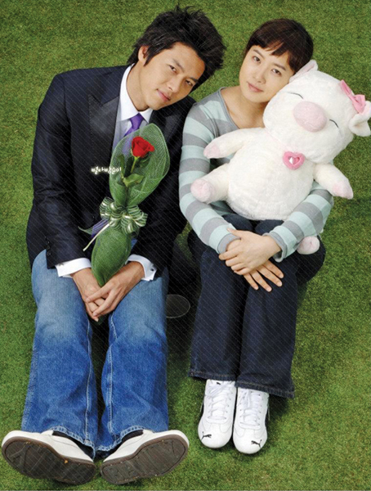

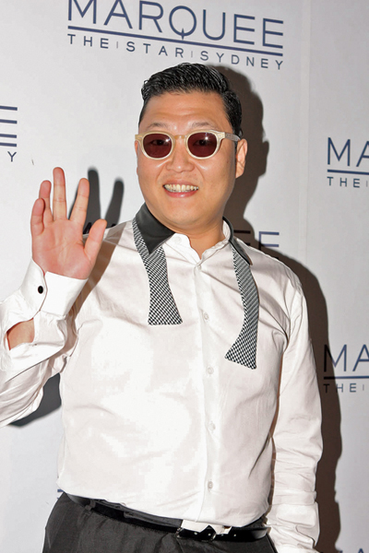

Hallyu: The Korean Wave
“The Korean Wave” describes the global popularity of South Korea’s pop culture, entertainment, music, TV dramas, movies, online games, graphic novels, fashion, food, and more.

Slide 5
Activity 8.1A:
Hallyu Research Assignment
With your partner, select a specific example of Hallyu to research and share.
  Share your idea with your teacher so that no one else chooses that example.
Conduct research on your example of Hallyu. Then, prepare a one-page report including the following:
  Title, author, and year originally published/created of the source
  50-word summary and description
  Reasons it has become internationally popular
  Whether the intended audience is children, youth, adults, or all the above
  Two images of the example
  One YouTube clip (less than 3 minutes long) of the example. Record the title, link, and time length on your report and submit the video clip URL to your teacher as required.

Slide 6

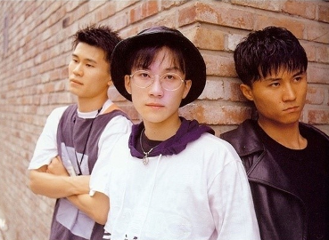
K-Pop
K-pop, short for Korean popular music, is a genre of music originating in South Korea.
It is influenced by styles and genres from around the world, such as pop, experimental, rock, jazz, gospel, hip hop, R&B, reggae, electronic dance, folk, country, and classical on top of its traditional Korean music roots.
The more modern form of the genre emerged with the formation of one of the earliest K-pop groups, the boy band Seo Taiji and Boys, in 1992.
Their experimentation with different styles and genres of music and integration of foreign musical elements helped reshape and modernize South Korea's contemporary music scene.
Seo Taiji and Boys, early 1990s. From left: Yang Hyun-suk, Seo Taiji, and Lee Juno.
Information retrieved from Wikipedia

Slide 7
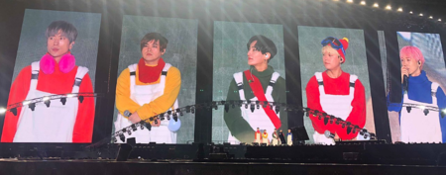


Modern K-Pop
H.O.T. reunion concert at Seoul Olympic Stadium in 2018. From L-R: Jaewon, Heejun, Kangta, Tony, and Woohyuk
Modern K-pop "idol" culture began with the boy band H.O.T. in 1996, as K-pop grew into a subculture that amassed enormous fandoms of teenagers and young adults.
After a slump in early K-pop, TVXQ and BoA started a new generation of K-pop idols that broke the music genre into the neighboring Japanese market and continues to popularize K-pop internationally today.
TVXQ , an initialism for Tong Vfang Xien Qi, is a South Korean male pop duo consisting of U-Know Yunho and Max Changmin.
Kwon Bo-ah, known professionally as BoA, has been dubbed the "Queen of K-pop" and is one of the most successful and influential Korean entertainers.
Information retrieved from Wikipedia

Slide 8


K-Pop Stars
As of 2019, K-pop is ranked at number six among the top ten music markets worldwide, according to the International Federation of the Phonographic Industry's "Global Music Report 2019.”
BTS and BLACKPINK are cited as artists leading the market growth.
In 2020, K-pop experienced a record-breaking year when it experienced a 44.8% growth and positioned itself as the fastest-growing major market of the year.
Information retrieved from Wikipedia

Slide 9
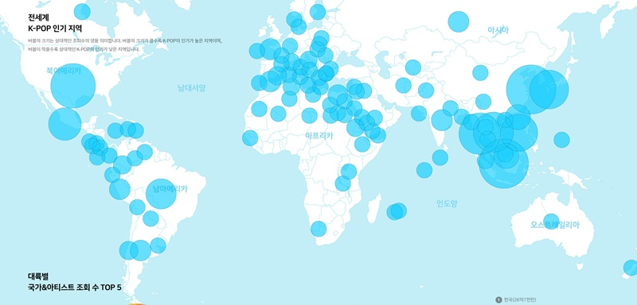
Map of K-Pop Popularity by Global Region (2019)
Based on YouTube clip data on 76 Korean idol acts between July 1, 2018 and June 30, 2019. The bigger the circle, the more popular K-pop is in the region. (Blip Research)

Slide 10
K-Pop vs. American Pop
How Are They Similar? How Are They Different?
K-Pop
American Pop
Originated in South Korea in late 1990s and morphed into K-pop in the 2000s.
Features catchy beats, hooks, rapping, and instrumentals for dance breaks.
Mosaic of music genres; medley of English and Korean; choreographed dance routines that are elaborate yet simple enough for fans to pick up.
Draws influence from a range of genres like pop, experimental, rock, hip-hop, R&B, electronic, and dance.
Uses a production line approach to talent; includes focus on fashion and style; typical band has average of seven members.
Songs have good rhythm, catchy melody, and are easy to remember and sing along with.
Usually includes several verses and a chorus that is repeated several times.
Originated in the United States in the early 1990s.
Draws from range of genres including folk, country, R&B, jazz, and rock and later included new styles such as heavy metal, punk, soul, and hip hop.

Slide 11
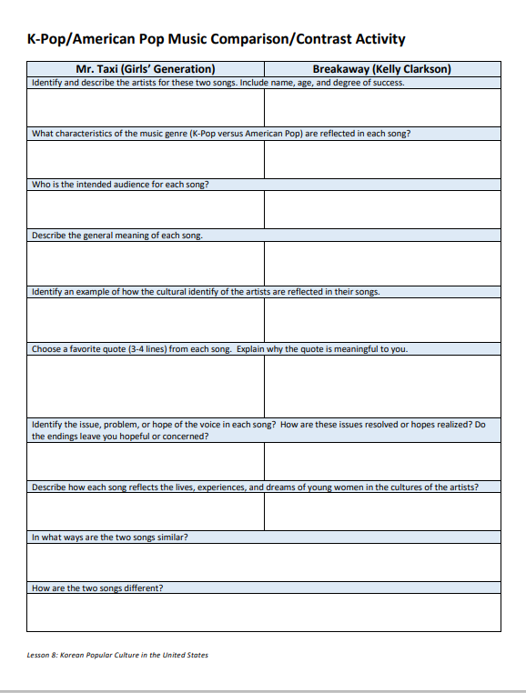


Activity 8.1B
K-Pop and American Pop Music Comparison/Contrast Activity
Identify similarities and differences between K-Pop and American pop by comparing and contrasting songs by Girls’ Generation and Kelly Clarkson.

Slide 12
Activity 8.2
Oscar Winners: A Closer Look at Minari

Slide 13
Activity 8.2 Questions
How have movies directed by or starring Koreans and Korean Americans made an international impact?
How does the film Minari shape your understanding of Korean American identity?
How might the increasing popularity of films by and about Koreans and Korean Americans impact the lives of Korean Americans today?

Slide 14


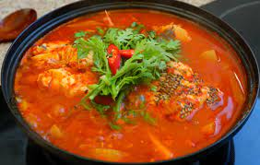
Minari
Minari is named after the Korean plant that grandma Soonja (Youn) grows in the woods. “Minari is a vegetable that you find a lot in Asia,” Chung said. “My grandmother brought over minari seeds from Korea and we planted those seeds in this little creek bed in Arkansas.”
Within Korean cuisine, minari is commonplace thanks to its crunchy, hollow stems and an abundance of leaves that taste like carrot tops or celery, with a slight peppery and bitter flavor to boot. It is frequently mixed into bibimbap, or cooked in maeuntang, a popular spicy fish soup.​

Slide 15
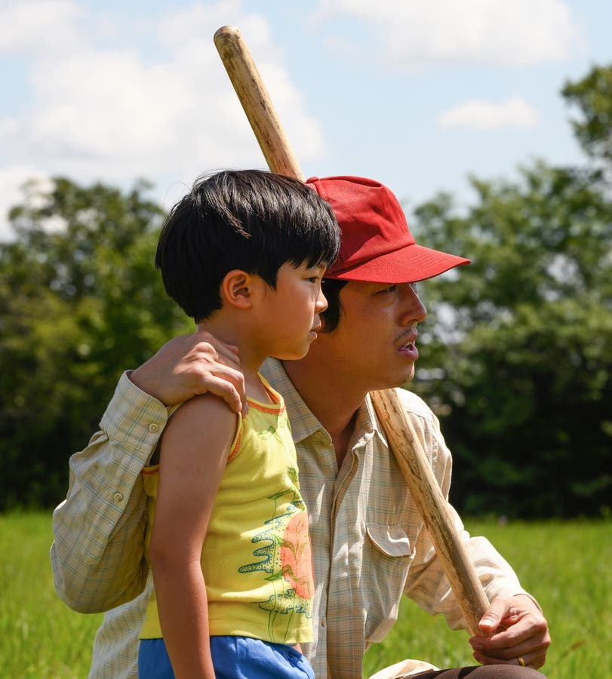
Minari Storyline
A Korean American family moves to an Arkansas farm in search of their own American Dream. Amidst the challenges of this new life in the strange and rugged Ozarks, they find the undeniable resilience of family and what really makes a home.
A semi-autobiographical take on Chung’s upbringing, the plot follows a family of South Korean immigrants who try to make it in the rural United States during the 1980s.

Slide 16
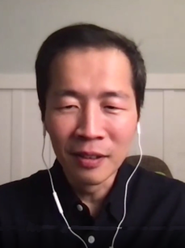
About Director Lee Isaac Chung
Lee Isaac Chung was born on October 19, 1978, in Denver, to a family from South Korea.
His family lived briefly in Atlanta before moving to a small farm in rural Lincoln, Arkansas.

Slide 17
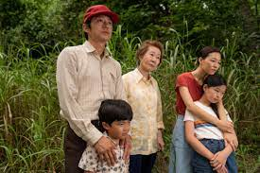
Main Characters
Jacob – father
Monica – mother
Soonja – grandmother
Anna – daughter
David - son

Slide 18

Minari

Slide 19
Activity 8.2 Minari Playlist
With at least one partner and no more than three others, choose and complete enough activities to earn a potential 90 points.
Level 1 Activities
(30 pts. each)
  Character Map
  Story Elements Graphic Organizer
  Story Sequence Chart
Level 2 Activities
(60 pts. each)
  Movie Critique Presentation/Video
  Movie Poster (digital or print)
Directions for each activity are available from your teacher.

Slide 20
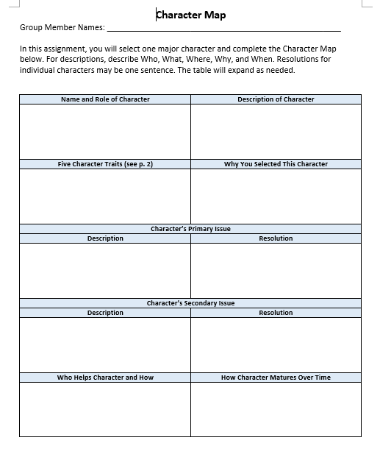
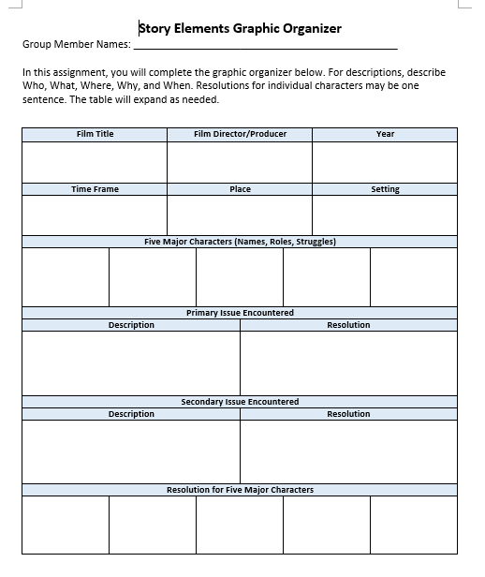

Level 1 Activities (30 pts. each)
Character Map
Story Elements Graphic Organizer
Story Sequence Chart

Slide 21
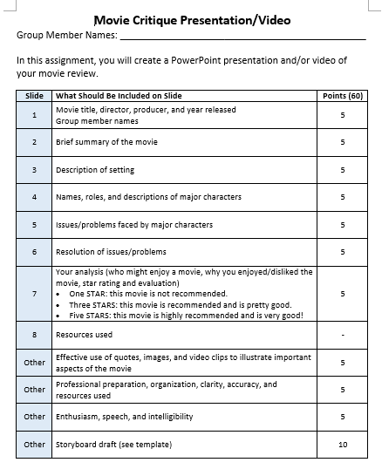

Level 2 Activities (60 pts. each)
Movie Critique Presentation/Video

Slide 22
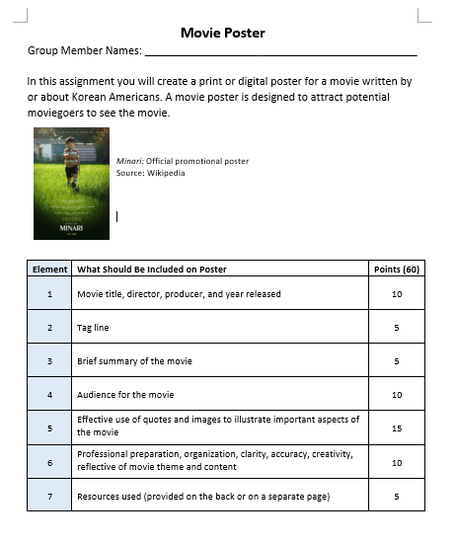
Level 2 Activities (60 pts. each)
Digital Movie Poster

Slide 23
Minari Discussion Questions
We are introduced to Minari through young David’s eyes. What do we see in the film because of this that we might not if it was told through the eyes of Jacob or Monica?
What does Jacob’s decision to grow Korean vegetables in Arkansas say about culture and identity?
Grandma sees David as an American kid, and Monica asserts that he’s a Korean kid. Who’s right? Is there a “right”?
This movie is deeply rooted in a place and in a time when Korean immigration was increasing by leaps and bounds. Yet it treats the question of belonging to a mostly white community as an immigrant with a light hand. What did you notice about the Yi family’s experience as immigrants?
How were your family's immigrant experiences similar to or different from the Yi family?
How does this film shape your identity as a Korean American?

Slide 24
Activity 8.3
Korean Americans Past, Present, and Future

Slide 25
Activity 8.3 Questions
What are differences between biographies, autobiographies, and memoirs?
How do memoirs help us understand how individuals developed their Korean American identity?
How have movies directed by or starring Koreans and Korean Americans made an international impact?
How have Korean Americans contributed to the United States and the world?
How have contributions of Korean Americans influenced your understanding of Korean Americans and their future?

Slide 26
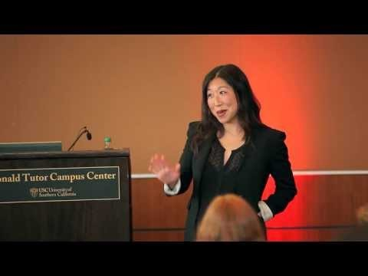
Korean Americans: Past and Present
Susie Woo, Associate Professor of American Studies at Cal State Fullerton, shares the struggles of Korean immigrants in the United States and the history that has brought them here.
Challenging many myths about Korean Americans, she shares her own story, while discussing the three waves of Korean immigration, their religion, pop culture, and Korean American achievement in a country they have come to call their own.

Slide 27
Examples of
Notable Korean Americans

Slide 28
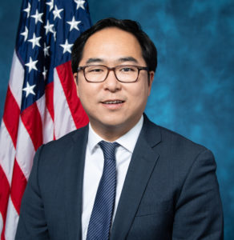
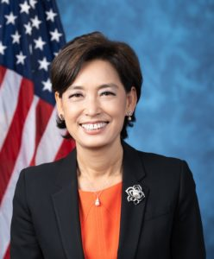
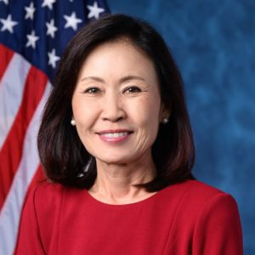

Korean Americans in U.S. Congress
Throughout the course of roughly a century since Koreans initially migrated to the United States, only two Koreans were elected to the U.S. House of Representatives.
  In 1992, Jay Kim (U.S. House of Representatives from California) became the very first Korean American to serve in Congress.
  Almost three decades later, in 2019, Andy Kim became the second Korean American to serve.
For the first time in history, four Korean Americans were sworn into the 117th Congress in 2021.
Andy Kim
New Jersey (D)
(2019-Present)
Young Kim California (R)
(2021- Present)
Michelle Park Steele
California (R)
(2021-Present)
Marilyn Strickland Washington(D)
(2021-Present)

Slide 29
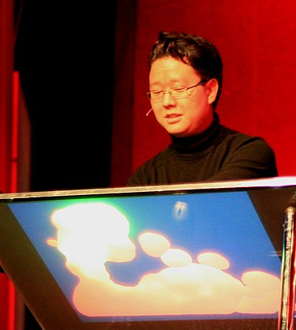

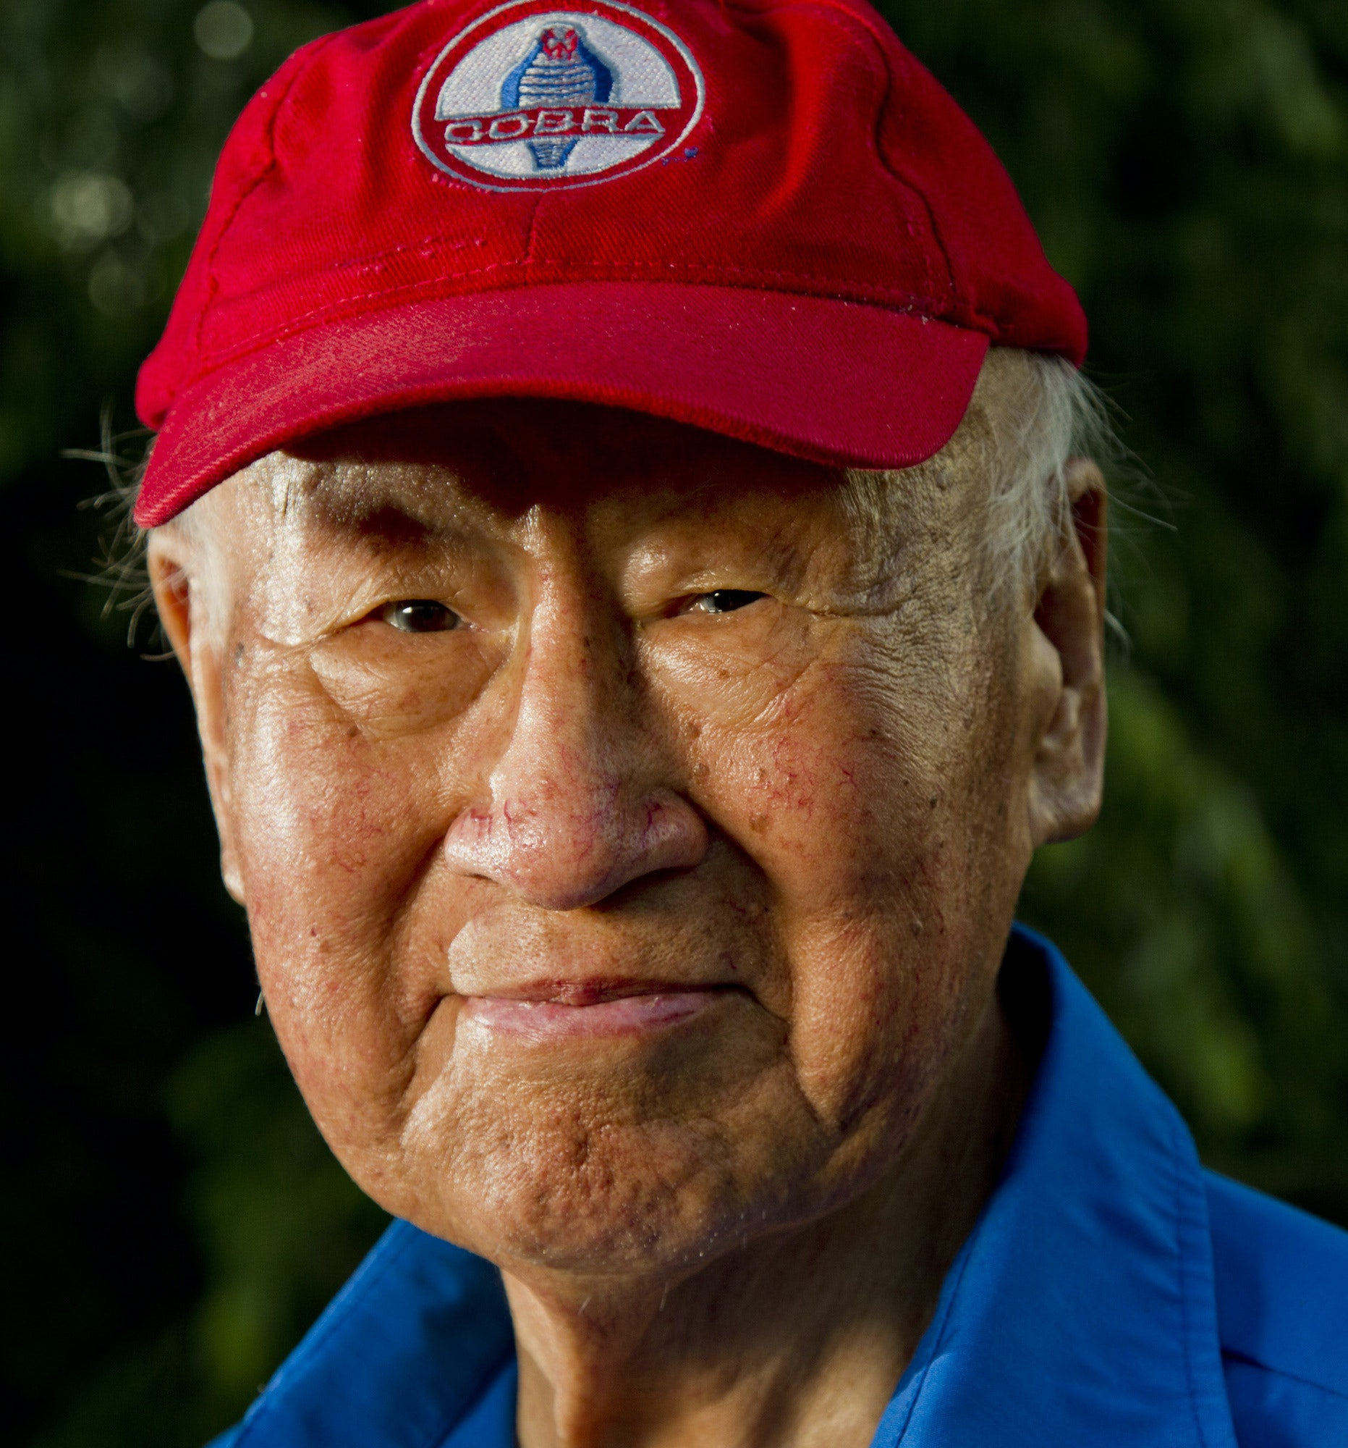

Korean American Scientists and Engineers
Jefferson Y. “Jeff” Han is one of the main developers for multi-touch sensing, which allows recognition of more than two points of contact with the surface of a television or computer. | Larry Kwak conducts cutting-edge research in the fields of immunology and cancer vaccinations. He is known for his innovation in the world’s first “cancer vaccine,” the lymphoma vaccine. | John Chun was a Korean American car designer, known for his design of the Shelby Mustang GT350 and GT500, which started distribution nationwide in 1967. | Peter S. Kim specializes in HIV/AIDS research and created compounds that prevent the AIDS virus from infecting cells, using the principle of membrane fusion.

Slide 30
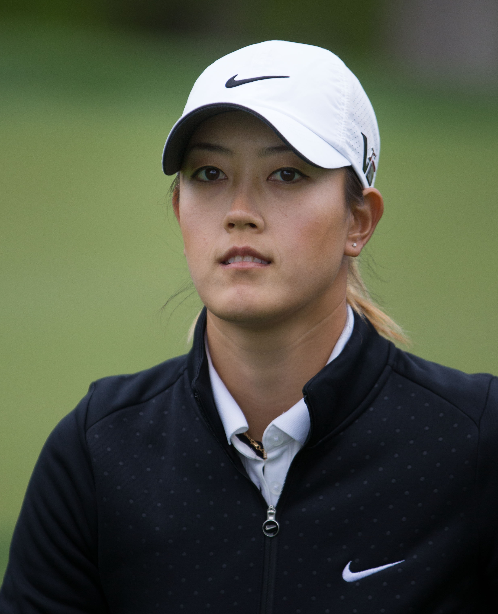
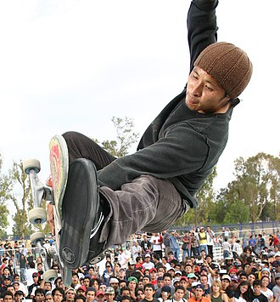

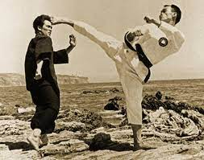
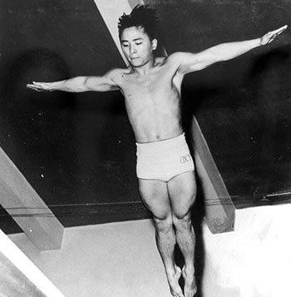
Korean American Athletes
Michelle Sung Wie West is an American professional golfer who plays on the LPGA Tour. At age 10, she became the youngest player to qualify for a USGA amateur championship. | Daewon David Song is an American professional skate-boarder and co-owner of Thank You Skateboards. Song was named the 2006 "Skater of the Year" by Thrasher magazine. | Kristie Hyerim Ahn is an American professional tennis player who has won seven singles titles and two doubles titles. Her first appearance at a Grand Slam tournament was at the age of 16 at the 2008 US Open. | Rhee Jhoon-goo was a South Korean master of taekwondo and recognized as the Father of American Taekwondo for introducing this martial art to the United States in the 1950s. | Sammy Lee was an American physician and diver. He was the first Asian American man to win an Olympic gold medal for the United States.

Slide 31
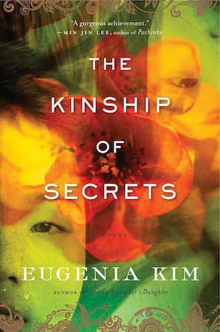
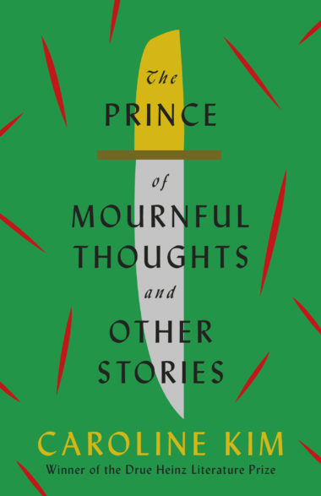



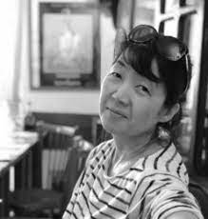


Contemporary Korean American Writers
Eugenia Kim | Caroline Kim | Steph Cha | Matthew Salesses

Slide 32
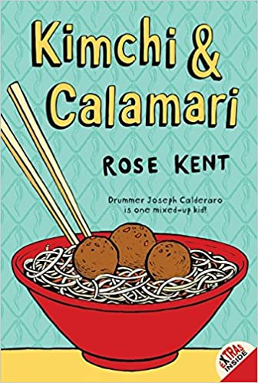
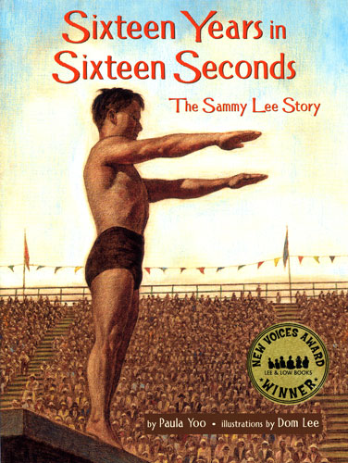

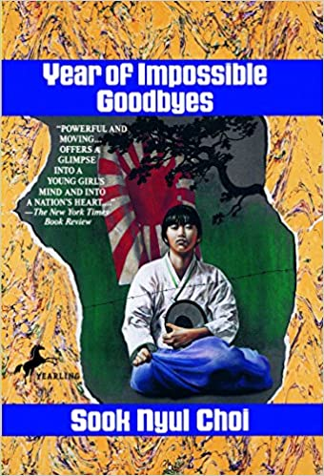

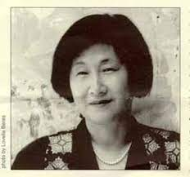

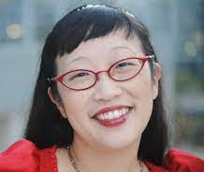
Korean American Children’s Literature Authors
Rose Kent | Paula Yoo | Tae Keller | Sook Nyui Choi

Slide 33
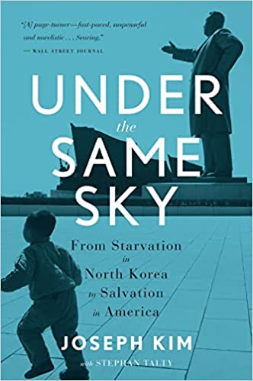
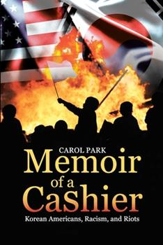
Biography vs. Autobiography vs. Memoir
BIOGRAPHY | AUTOBIOGRAPHY | MEMOIR
Written about another person and told in third person point of view (POV) More formal and objective than both memoirs and autobiographies Broad in scope or timeline, often covering the subject’s entire life Focused solely on facts Requires meticulous research and fact-checking to ensure accuracy | Written in first person POV from the perspective of the author, occasionally with a collaborator More formal and objective than memoirs, but more subjective than biographies Broad in scope or timeline, often covering the author’s entire life Focused more on facts than emotions Requires more extensive fact-checking and research than memoirs, but less than biographies | Written in first person POV from the perspective of the author Less formal compared to autobiographies and biographies Narrow in scope or timeline Focused more on feelings and memories than facts More flexibility to change the story for effect

Slide 34
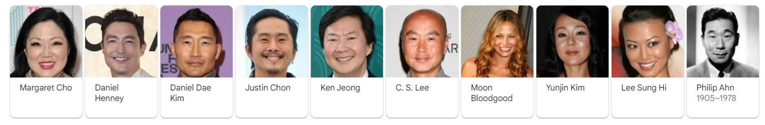
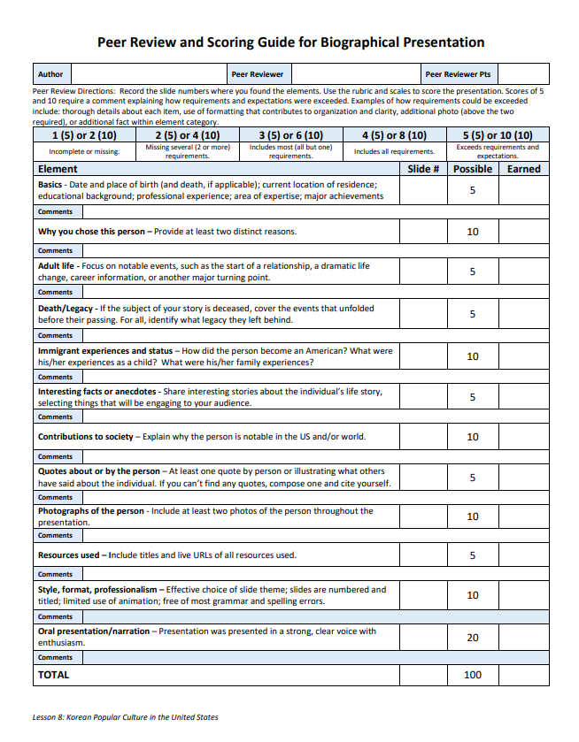
Notable Korean Americans
Biography Research Presentation
PowerPoint Presentation and Oral Presentation or Narrated Video About a Notable Korean American
Biographical
Will be peer reviewed
Elements to Include:
Basics
Why you chose person
Adult life
Death/legacy
Immigrant experiences and status
Interesting facts and antidotes
Contributions to society
Quotes and photographs

Slide 35
Summative Assessment
Memoir Essay

Slide 36
THE WRITING PROCESS
PREWRITE
REVIEW & REVISE
EDIT & PUBLISH
PLAN & OUTLINE
COMPOSE FIRST DRAFT
Five Steps of the Writing Process

Slide 37
What Is a Memoir Essay?
WRITING PROMPT: Compose a five-paragraph memoir essay in which you recount an experience in your lifetime that reveals something about your identity as a Korean American.
A memoir essay is a narrative, written from the perspective of the author, about an important part of their life.
Memoir authors choose a pivotal moment in their lives and try to recreate the event through storytelling.
Memoirs still include all the facts of the event, but authors have more flexibility here because they are telling a story as they remember it, not as others can prove or disprove it.

Slide 38
Memoir Excerpts
“Sometimes in the years leading up to the Korean War, the exact dates are unknown or, perhaps, obscured, my mother’s father was slated for execution.” (The Loneliest Americans, 2021, Jay Caspian Kang)
“Daejeon 1972, 140 kilometers south of Seoul: my grandmother Jun, thirty-two, sewed skirts for her fourteen-year-old daughter, my mother, on a seat at the Western table in her two-story home. Jun crossed her knees, fluffing her chiffon dress, which she paired with rich green indoor slippers.” (Magical Language of Others: A Memoir, 2020, E.J. Koh)
I just didn’t understand. I didn’t get it that the station was truly our lifeline. The business provided the roof over my head, the food on my plate, the snack I was eating at that very moment. All we had to do was survive. Mom knew the only way to do that was by working hard. So how could she just sell the station?
“You just have to learn to deal with this kind of stuff,” she said. “Don’t let it bother you.”
But how could I not? (Memoir of a Cashier, 2017, Carol Park)
“My toy soldier peers over a mound of dirt not far from where my father, my mother, have just finished our picnic Daedong River in Pyongyang. My father and I are setting up the soldiers to reenact one of the decisive battles in which our eternal leader, Kim Il Sung, ousted the Japanese army from our country. I am carrying a wooden pistol that my father carved for me. My mom is playacting as my army nurse.” (Every Falling Star: The True Story of How I Survived and Escaped North Korea, 2016, Sungju Lee)

Slide 39
Types of Memoirs
Coming of Age Memoir: A memoir that highlights the transformation of the writer from childhood to adulthood. The writer shares events and experiences from childhood and their significance.
Confessional Memoir: A memoir in which the writer shares their sins and wrongdoings and how they amended and reformed their ways.
Personal Memoir: A memoir that discusses a certain experience or event. It is the most common form of memoir.
Political Memoir: A memoir in which the writer is usually a public officer who shares historical records and other experiences.
Portrait Memoir: A memoir in which the author does not share their personal experience but someone else’s story or an event.
Spiritual Quest Memoir: A memoir in which the writer is usually a spiritual seeker. The writer talks about searching for spiritual meaning and the purpose of things.
Travel Memoir: A memoir that focuses on the writer’s travel experience and adventures.
Adapted from My Perfect Words

Slide 40

Memoir Essay
The essay should have smooth transitional words and sentences that help illuminate and connect relationships among ideas.
The essay should be typed in Calibri or Times New Roman 12-point font, double-spaced, with 1” margins. Otherwise, write neatly in black or blue ink, double-spaced, and use the paper’s margins.
Attach the original Memoir Essay Plan to your final essay.

Slide 41
Memoir in 3 Acts
MEMOIR ESSAY IN THREE ACTS
ACT DESCRIPTION | OUTLINE EXAMPLE
Act 1: Introduce the main person and others involved in the story by names, relationships, and personalities. Set the scene. “Hook” the reader’s interest. This begins the lead into Act Two, which includes the drama, problems, conflicts, etc. that are about to happen. | Explain that I am not popular: I am shy. My date for the prom is the most popular and best-looking person in school. I was asked to the prom in front of almost the whole school. The excitement I felt about this date; choosing clothes to wear. My next-door neighbor and friend (two years behind me in school) telling me it’s all a setup to embarrass me.
Act 2: Problems become more muddled and complex as shown through scenes of actions and reactions that highlight your journey toward change, transformation, and discovering of what is true or false. | The emotions around believing my friend or trusting my date, which I really want. I become paranoid that people in school were talking or laughing behind my back. My changes in feelings from everyone knowing this was a setup or that I was imagining it. The decision-making process to talk with my date about this or keep silent and go to the prom.
Act 3: Conflicts and problems reach a climax and end with a learning experience. There are many types of endings (e.g., the reader feels happy, sad, satisfied, leaves with something to think about, etc.). The ending should leave the reader with the feeling that the story is concluded. | The decision to talk to date about what neighbor told me. My date admits it’s a setup and feels bad about participating. The date has a change of heart and apologizes. The prom date is broken; now I no longer am going to the prom. My friend from next door comes to the rescue and takes me to prom. We become even better friends, fall in love, and marry.

Slide 42



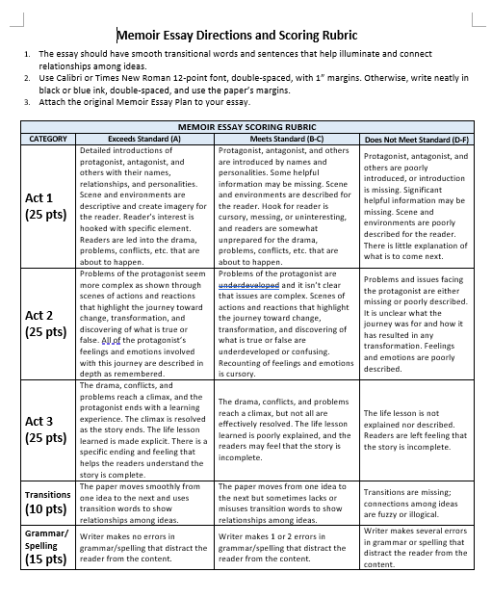


Memoir Essay Scoring Rubric

