Slide 1
Lesson 7
Saigu:
The 1992 LA Civil Unrest

Slide 2
Activity 7.1
A Cry for Justice

Slide 3
Activity 7.1 Questions
What events occurred during the 1992 LA Civil Unrest?
Who was involved in the unrest and what were their roles?
What were some outcomes of the unrest?
How does civil unrest affect communities who have limited access to financial or social support?
How has this incident shaped issues of justice and injustice for Korean Americans?

Slide 4
Brainstorm Definitions
In pairs or groups, define the following six terms.
Be prepared to share your ideas.
UPRISING
CIVIL UNREST
JUSTICE
riot
INJUSTICE
advocate

Slide 5
What Was Saigu?
Saigu, otherwise known as the 1992 Los Angeles riots, were a series of riots and civil disturbances that occurred in Los Angeles County in April and May 1992.
Unrest began in the Koreatown area of South Central Los Angeles on April 29, after a jury acquitted four officers of the Los Angeles Police Department (LAPD) charged with using excessive force in the arrest and beating of Rodney King.
This incident had been videotaped and widely shown in television broadcasts.

Slide 6
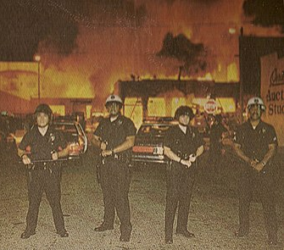
What Happened During Saigu?
Thousands of people rioted over six days following the Rodney King verdict announcement.
Widespread looting, arson, and assault occurred, which local police forces had difficulty controlling due to lack of personnel and resources.
The situation was resolved after 5,000 troops were deployed by the California National Guard, U.S. military, and several federal law enforcement agencies.

Slide 7
What Were Outcomes of Saigu?
When the riots ended, 63 people had been killed, 2,328 had been injured, more than 10,164 had been arrested, and estimates of property damage were over $1 billion.
Koreatown, where the bulk of the rioting in South Central Los Angeles occurred, received disproportionately more damage than surrounding areas.
LAPD Chief of Police Daryl Gates, who had already announced his resignation by the time of the riots, was attributed with much of the blame for failure to de-escalate the situation and overall mismanagement.
Deaths: 63
Injuries: 2,328 (228 critical)
Arrests: 10,164
Fires: 6,405
Damages: Over $1 billion

Slide 8
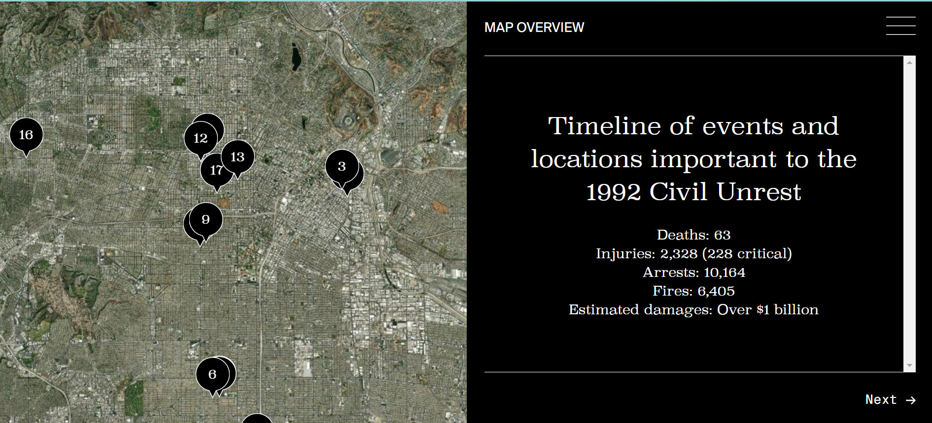
Activity 7.1
Use the interactive map at K’TOWN MAP to complete the Saigu Timeline of Events Worksheet.
Be prepared to share your questions in a small group or a whole class discussion.

Slide 9
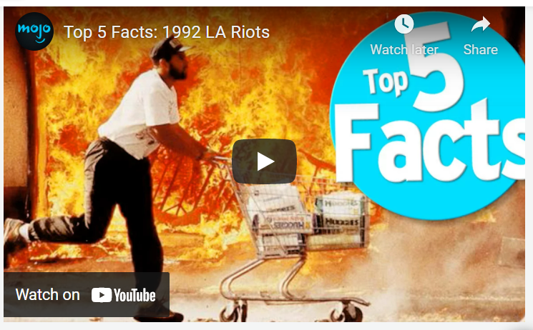
Mojo’s Top 5 Facts: 1992 LA Riots

Slide 10
Who perceived that they received/dispensed justice? Who perceived that they received/dispensed injustice?
Rodney King Latasha Harlins Soon Ja Du Sgt. Koon and Officers Powell, Briseno, and Wind | Reginald Denny Fidel Lopez Shop Owners Rioters Police Officers Bystanders | Children Community Members Korean Americans Black Americans Lationo/Hispanic and who else?
As you watch the video, take note on the T-Chart: Justice vs. Injustice worksheet of examples of perceived justice and injustice (both to and from whom) presented in the video.

Slide 11
Think-Pair-Share
What is the difference between justice and injustice?
What examples of injustice did you see in the story of Saigu?
Who benefits from injustice?
Who benefits from justice?
How might advocates impact injustice?

Slide 12
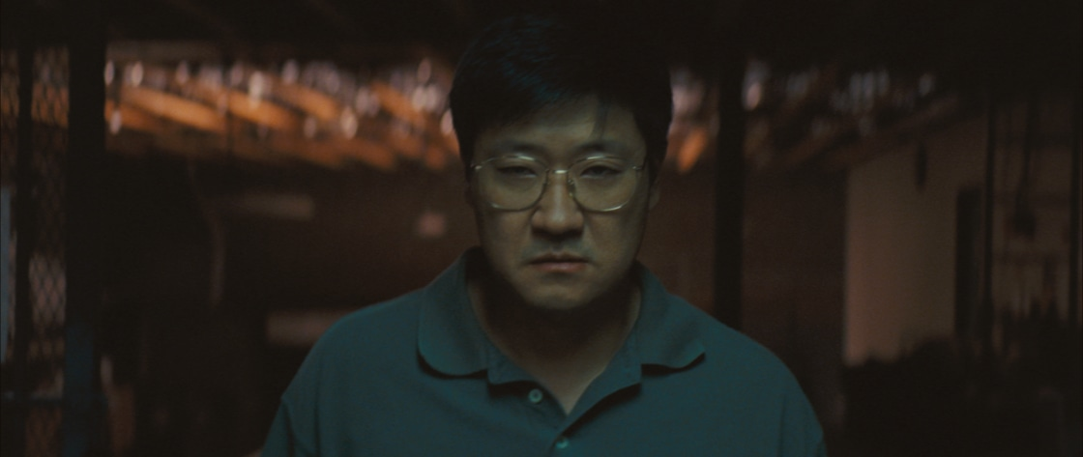
April’s Way: a 1992 LA Riots Short Film

Slide 13
Revisit: Think-Pair-Share
How has the April’s Way video reshaped or reinforced
your answers to these questions?
What is the difference between justice and injustice?
What examples of injustice did you see in the story of Saigu?
Who benefits from injustice?
Who benefits from justice?
How might advocates impact injustice?

Slide 14
Activity 7.2
Experiences of Korean Americans during the 1992 LA Civil Unrest

Slide 15
Activity 7.2 Questions
How were Korean Americans (both those who lived during the event and those who have been born since) impacted by the 1992 LA Civil Unrest?
What are similarities and differences between these experiences?
What did they see as some of the causes of the 1992 LA Civil Unrest?
What impact was felt in the Korean American community?
What impacts were felt by other groups (i.e., the LAPD, African American population, Latino/Hispanic population, etc.)?

Slide 16
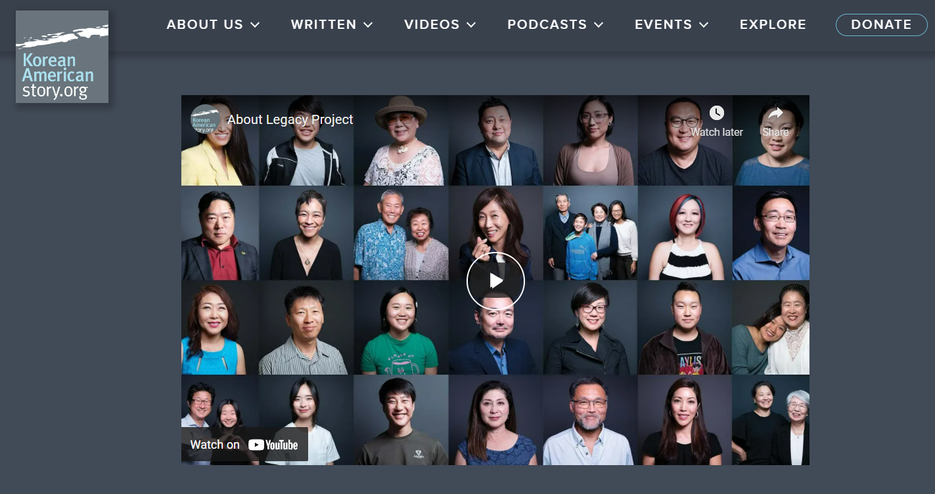
What Is the Legacy Project?
The Legacy Project was established to capture, create, preserve, and share the stories of the Korean American experience by supporting and promoting storytelling in all forms that explore and reflect the ever-evolving Korean American story.

Slide 17
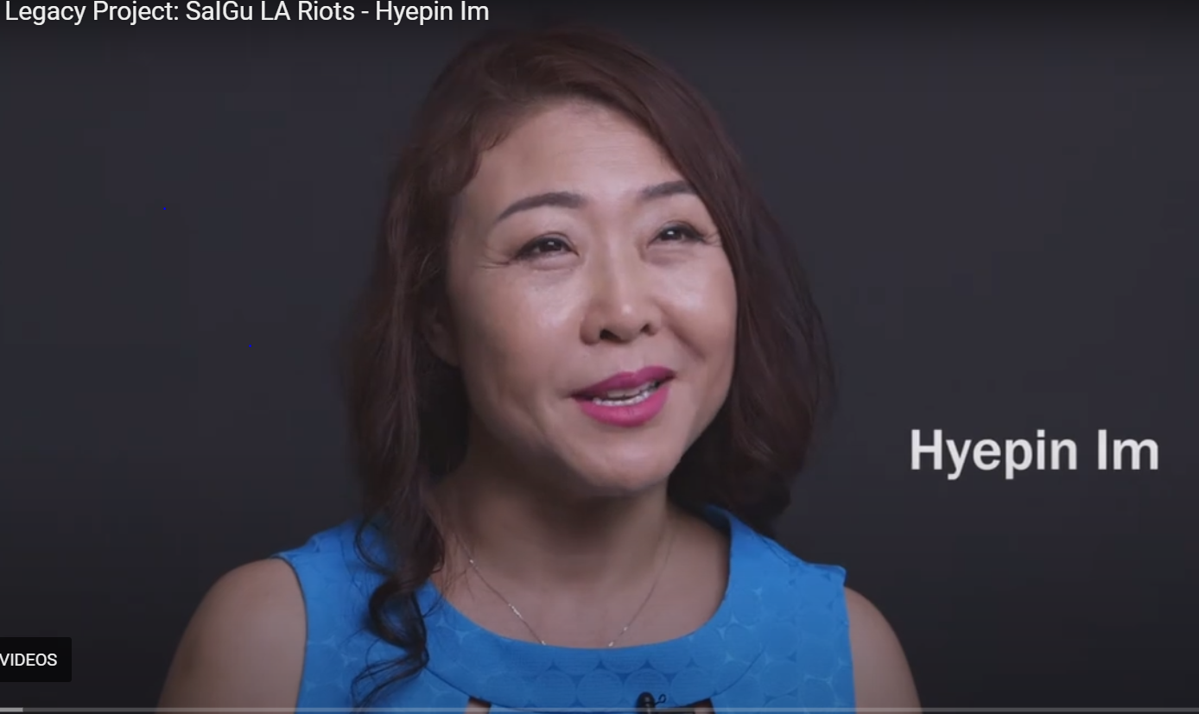
Video: Legacy Project: Saigu LA Riots - Hyepin Im

Slide 18
Similarities and Differences
What were common experiences of Korean Americans who were part of the 1992 LA Civil Unrest?
What were some unique or uncommon experiences of Korean Americans who were part of the 1992 LA Civil Unrest?

Slide 19
Activity 7.3
The Legacy of Saigu

Slide 20
Activity 7.3 Questions
What is the Saigu legacy?
In the South Central neighborhoods of Los Angeles, how have race relations changed since Saigu? How have they stayed the same?
Being caught between two worlds, how do Korean Americans (immigrants) feel the pressures and the divide in the U.S. along racial lines, especially as they enter small businesses and urban communities?
What racial inequalities and mistreatment of Korean Americans during the 1992 LA Civil Unrest persist today?
How does your new understanding of Korean American experiences impact your understanding of Korean American identity?

Slide 21
Quick-Write
A legacy is something that is carried over from a previous generation and handed down to the next. It is believed that building a legacy helps establish stronger communities, but a legacy may also have negative implications.
Write for 5 minutes about what is you feel is the Saigu legacy. Use these questions to guide your response:
What is a legacy?
What is the Saigu legacy? How does it differ for different individuals or groups?
Who are all the individuals and groups that contributed to handing down the Saigu legacy?
Who are all the individuals and groups that were (and continue to be) impacted by the Saigu legacy?
What could be done in the future to reshape the legacy of Saigu?

Slide 22
Paired Reading
Choose which article you and your partner will read.
Read and answer the appropriate questions.
Share your answers with your partner and update your Quick-Write by comparing/contrasting these ideas.
25 Years After LA Riots
What might Edward Chang, Carole Park, and Korean American merchants feel is part of the Saigu legacy? Make a list of these elements and add this answer to your Quick-Write.
Korean Liquor Store
What might Soon Yoon, Simon Choi, and the Korean American Federation feel is part of the Saigu legacy? Make a list of these elements and add this answer to your Quick-Write.

Slide 23
Summative Assessment
Causes/Effects T-Chart: The 1992 LA Civil Unrest

Slide 24
Cause/Effect Relationships
“Cause and Effect” is a relationship between events or things, where one is the result of the other or others. This is a combination of action and reaction. Something happens (A cause) that leads to an outcome (an effect). There may be multiple cause for one effect, and multiple effects from one cause.
Cause It rained for four hours. She worked extra hours and saved her money. | Effect The road flooded and the dog was trapped in the water. She was able to pay for college.

Slide 25
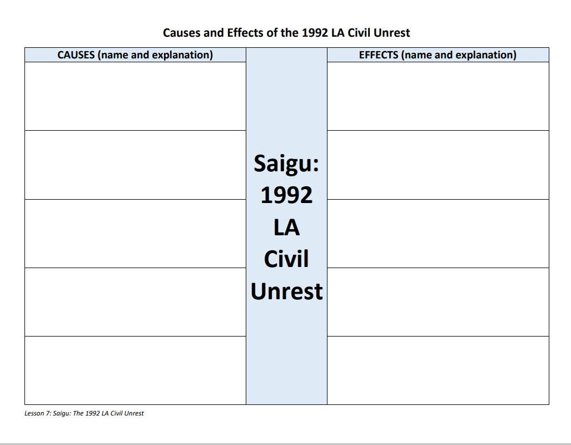
T-Chart of Causes/Effects of the 1992 LA Civil Unrest
Using the Causes/Effects T-Chart to students, identify and explain at least five causes and effects of the 1992 LA Civil Unrest.
Draw ideas from lectures, readings, and your completed Timeline, Justice T-Chart, Legacy Project Interview Analysis, and Legacy Quick-Write assignments.
You may also use the Web.

Slide 26
Causes/Effects T-Chart Scoring Guide
This T-Chart is assigned in lieu of an essay, but causes and effects should be carefully composed as though each item is part of an essay.
Requirement | Points (100 possible)
Causes Descriptive title of cause Minimum 50-word relevant explanation that includes time frame of and who was involved in cause | 5 @ 10 each = 50 pts
Effects Descriptive title of cause Minimum 50-word relevant explanation that includes time frame of and who was impacted by effect | 5 @ 10 each = 50 pts
Typed, minimum grammar and spelling errors, use of complete sentences, well organized | 10-point deduction

Slide 27
Reading/Writing Extension
Autobiographical Book Review
Autobiographical Essay

