Slide 1
Lesson 5
Young Oak Kim: Hero and Humanitarian

Slide 2
Lesson 5.1
Who Was the First Asian American to Command a U.S. Battalion?
How Did Young Oak Kim Combat Racism?

Slide 3
Activity 5.1 Discussion Questions
Who was Young Oak Kim? Who was the first Asian American to command a U.S. battalion?
​Colonel Young Oak Kim’s story demonstrates how racism permeated even the U.S. military. How did Young Oak Kim combat racism? What lessons about racism can we learn from his story?
What contributions did Young Oak Kim make to his community and the United States?
How do contributions of Asian American and Pacific Islanders, such as Colonel Kim, help us understand how ethnic minorities are treated in the U.S. military and as civilians?
Why is it important to learn about diversity, immigrants, and racism in the United States?

Slide 4
How Have You Encountered Racism or Microaggressions?
A microaggression is a statement, action, or incident regarded as an instance of indirect, subtle, or unintentional discrimination against members of a marginalized group such as a racial or ethnic minority.
Microaggressions are more than just insults, insensitive comments, or generalized jerky behavior. They're something very specific: the kinds of remarks, questions, or actions are painful because they have to do with a person's membership in a group that's discriminated against or subject to stereotypes.
Racism is prejudice, discrimination, or antagonism directed against a person or people on the basis of their membership in a particular racial or ethnic group, typically one that is a minority or marginalized.
Racism is often based on the belief that different races possess distinct characteristics, abilities, or qualities, especially so as to distinguish them as inferior or superior to one another.
Please be respectful of others as they share their experiences.

Slide 5
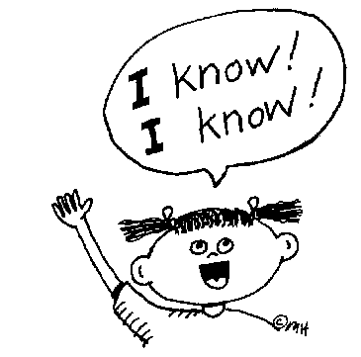
What Do You Know about Colonel Young Oak Kim?
WHAT WE KNOW | HOW WE FELT | WHAT WE LEARNED

Slide 6
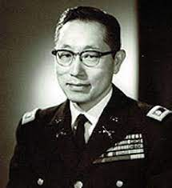
Young Oak Kim (1919–2006)
What does this image tell you about
Young Oak Kim?
Young Oak Kim Source: Wikipedia

Slide 7
Who Was Young Oak Kim?
Young Oak Kim was born in 1919 and died in 2005.
Kim was a U.S. army officer during World War II and the Korean War and a civic leader and humanitarian.
He was a member of the U.S. 100th Infantry Battalion and 442nd Regimental Combat Team and a combat leader in Italy and France during World War II.
He was awarded 19 medals, including the Distinguished Service Cross, two Silver Stars, two Bronze Stars, three Purple Hearts, a Bronze Medal of Military Valor, a Légion d'honneur, a Croix de guerre, and (posthumously) the Korean Taeguk Cordon of the Order of Military Merit.
After his military career, Kim dedicated his life to public service and was an active founder and leader of several nonprofit organizations for underserved communities throughout Southern California.
In May 2016, members of the Congressional Asian Pacific American Caucus held a press conference, organized by the Council of Korean Americans, to call on President Barack Obama to posthumously award Kim the nation’s highest civilian honor, the Presidential Medal of Freedom.

Slide 8
Examples of Young Oak Kim’s Legacy
In 1975, he helped found the Korean Youth and Cultural Center, now known as the Koreatown Youth and Community Center, which helps over 11,000 immigrants from Asia and Latin America each year.
Kim further served the Korean American community as a founding member of the Korean American Coalition (KAC) from 1985 to 2005.
In 1986, Kim co-founded the Korean Health, Education, Information, and Referral Center to provide new, uninformed immigrants with the health care information and services that they are entitled to receive by law in America.
From 1989 until 2005, he served as Chair of 100th/442nd/MIS Memorial Foundation, a veteran’s association of Japanese American soldiers who fought during World War II. Under his leadership, the organization worked directly with teachers and provided them with lesson plans to tell students the story of these Army units and cultivate a sentiment of national pride and respect in schools throughout the U.S.
Kim also co-founded other organizations that continue to educate the public: the Go For Broke Monument, the Go For Broke Educational Foundation, and the Japanese American National Museum.
In 2008, a newly opened middle school in Los Angeles' fourth local district was named Young Oak Kim Academy.
In 2010, the Young Oak Kim Center for Korean American Studies opened at the University of California, Riverside.

Slide 9
As You View/Read . . .
Take notes about moments where Kim encountered racism or microaggressions. How did he respond?
From Microaggressions

Slide 10
Think/Write/Pair Share/Group Share How Did Young Oak Kim Combat Racism?
Think for 1 minute about how Young Oak Kim encountered and responded to racism.
Write for 1 minute about the details and facts you can remember from each of the resources. (Be sure to identify which source provided which details.)
Pair Share for 1 minute per person, sharing what you’ve written about Young Oak Kim.
Join another pair of students and Group Share for 5–10 minutes. Identify what ideas you have in common and which ideas are unique. Be ready to share with the class.

Slide 11
Tips for Responding to Microaggressions
RESTATE OR PARAPHRASE
I think I heard you saying _____ (paraphrase their comments). Is that correct?
ASK FOR MORE INFORMATION
Could you say more about what you mean by that?
SEPARATE INTENT FROM IMPACT
I know you didn’t realize this, but when you _____ (behavior), it was hurtful/offensive because _____. Instead, you could _____.
EXPRESS YOUR FEELINGS
When you _____ (comment/behavior), I felt _____ (feeling) and I would like you to _____.
CHALLENGE THE STEREOTYPE Give information, share your own experience, and/or offer alternative perspectives.
Actually, in my experience, _____.
I think that’s a stereotype. I’ve learned that ______.
See more ideas at Responding to Microaggressions

Slide 12
Lesson 5.2
How Is Colonel Young Oak Kim an Unsung Hero?

Slide 13
Lesson 5.2 Discussion Questions
How was Young Oak Kim an unsung hero?
Why is it important to study the stories of individuals like Young Oak Kim?
​How did Colonel Kim make critical contributions to the Japanese American community, as well as to the progress of civil rights of all racial minority communities in the United States?

Slide 14
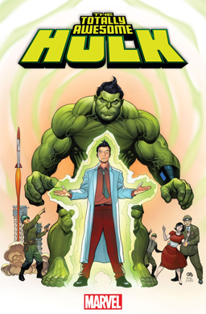
What Is a Hero? How Is Amadeus Cho a Superhero? What Real-Life Heroes Can You Name?
Amadeus Cho
Marvel comics superhero
19-year-old Korean American genius and one of the smartest people on Earth
Superhero with Hulk abilities
Amadeus Cho Source: Wikipedia

Slide 15
What Is an Unsung Hero?
A hero is a person who is admired or idealized for courage, outstanding achievements, or noble qualities.
An unsung hero is a hero who does great deeds but receives little recognition for them.
CHARACTERISTICS OF A HERO
BRAVE | CONVICTED | COURAGEOUS | DETERMINED
HELPFUL | HONEST | INSPIRATIONAL | VIRTUOUS
PROTECTIVE | SELF-SACRIFICING | SELFLESS | STRONG

Slide 16
Unsung Hero: The Story of Colonel Young Oak Kim
This book isn't just another tale of a war hero.
Kim has a special place not only in American and Korean history but also in world history.
Colonel Kim served in World War II and the Korean War as an officer leading the U.S. Army's 100th Infantry Battalion. Kim, a Korean American, led the famous Japanese American battalion and helped bridge the racial and cultural gap between the two ethnicities. His dedication, integrity, spirit, and loyalty earned him the respect of white officers in a time when racism was prevalent.
A champion of human rights, Kim believed that helping others was the best way to prevent strife and ultimately war.
When he retired, Kim helped establish numerous nonprofit organizations in Los Angeles, California.
He spent the rest of his retired years serving underprivileged and minority populations such as orphans, adoptees, women, and Asian Americans.
(from Unsung Hero: The Colonel Young Oak Kim Story book, back cover)

Slide 17
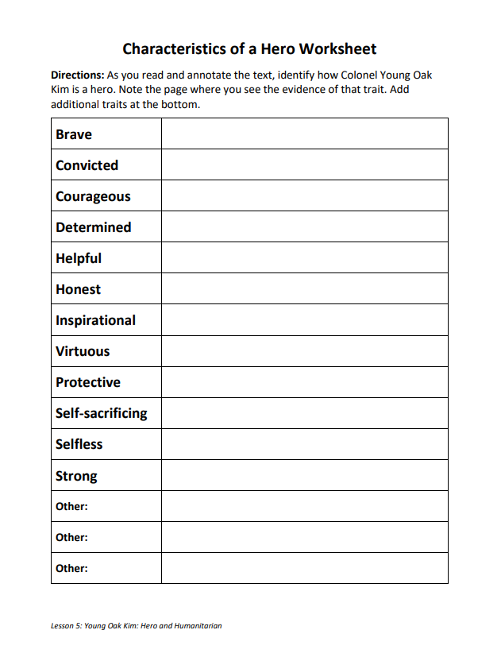
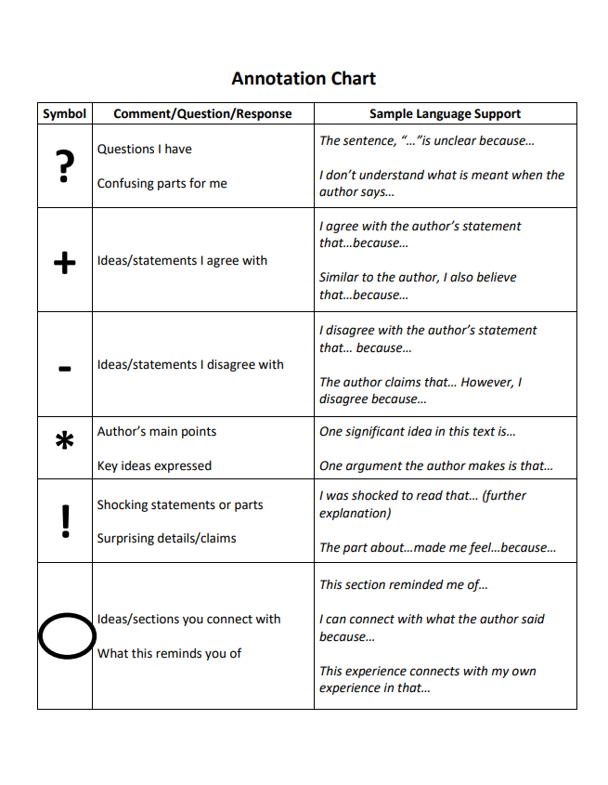
Activity 5.2
As you read:
Complete the Characteristics of a Hero Worksheet by recording examples of hero characteristics. (EX: Kim was "BRAVE" because he served in the army.)
Use the annotation chart to make notes.

Slide 18
Lesson 5 Assessments

Slide 19
What Is an Argumentative Essay?
An argumentative essay is a piece of writing that takes a stance on an issue.
In a good argumentative essay, the writer attempts to persuade readers to understand and support their point of view about a topic by stating their claim, reasoning, and providing evidence to back it up.
Argumentative essays should have a straightforward structure so they are easy for readers to follow. The goal of an argumentative essay is to clearly outline a point of view, reasoning, and evidence.

Slide 20
Parts of the Argumentative Essay
A good argumentative essay should follow this structure:
Introductory paragraph
Includes outline of topic, background information necessary to understand your argument, outline of the evidence you will present, and your thesis statement.
The thesis statement
Concise, one-sentence summary of your main point and claim.
Body paragraphs
Three or more paragraphs that explain the reasons why you support your thesis.
Each body paragraph should cover a different piece of evidence and contain a topic sentence that clearly and concisely explains why the reader should agree with your position. Body paragraphs are where you back up your claims with examples, research, statistics, studies, and text citations.
Here is where you will also present opposing points of view and disprove them or explain why you disagree with them. Presenting facts and considering a topic from every angle adds credibility and will help you gain the reader’s trust.
Conclusion
One paragraph that restates your thesis and summarizes all the arguments made in your body paragraphs.
Rather than introducing new facts or more arguments, a good conclusion will appeal to a reader’s emotions. In some cases, writers will use a personal anecdote explaining how the topic personally affects them.

Slide 21
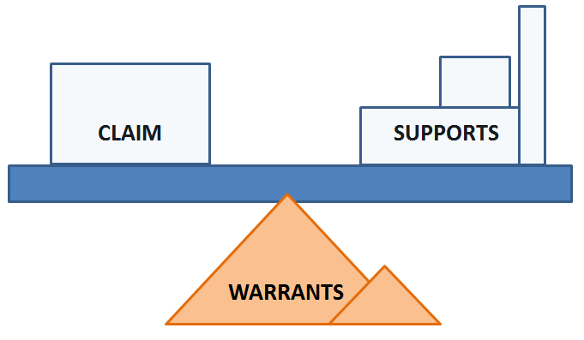
How to Construct an Argument
There are three major and necessary parts of an argument.

Slide 22
The Claim
Main point, thesis, controlling idea
Claim should be clearly stated at beginning of argument
Found by asking “What is the author trying to prove?”
Example of Claim:
You should plan a trip to a Disney theme park.

Slide 23
Support
Reasons given in support of the claim
Also known as evidence, proof, data, arguments, or grounds
Support can be facts and figures, expert opinion, examples, explanations, and logical reasoning
Found by asking “What does the author say to persuade the reader of the claim?”
Example of Support:
According to Gielan’s research, “97 percent of respondents reported having a trip to a Disney theme park planned makes them happier.”

Slide 24
Warrants
Assumptions or presuppositions underlying the argument
Generally accepted beliefs and values, common ways our culture or society views things (so usually no supports)
Author and audience may share warrants, or warrants of each may be in conflict
Provide the underlying reasons linking the claim and support
Found by asking “What’s causing the author to say these things?” or “Where is the author coming from?”
Example of Warrant:
People want to have a fun experience.

Slide 25
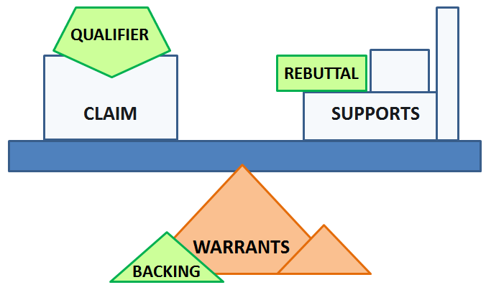
Additional Elements that Strengthen an Argument
Qualifiers to the Claim
Because an argument is about probability and possibility, not about certainty, don’t use superlatives like all, every, absolutely, never, none, no one.
Qualify your claim with expressions like many, many times, some, rarely, few, possibly.
Rebuttal for the Supports
Take into consideration conflicting viewpoints and deal with them fairly.
Respond to possible objections.
Backing for the Warrants
Sometimes warrant needs evidence to support it and make it more believable.

Slide 26
SAMPLE ARGUMENT CONSTRUCTION
CLAIM | You should plan a trip to a Disney theme park.
CLAIM QUALIFIERS | If you want to be happy, you should plan a trip to a Disney theme park.
SUPPORTS | According to Gielan’s research, “97 percent of respondents reported having a trip to a Disney theme park planned makes them happier.”
SUPPORT REBUTTALS | Other amusement parks can be fun, but people prefer Disney parks more than any other.
WARRANTS | People want to have a fun experience.
BACKING | Children, in particular, will have a great time at a Disney theme park.

Slide 27
Compose an Argumentative Essay
​You will construct an argument in a formal essay.
Requirements:
Peer-reviewed and teacher-approved Argument Construction Worksheet
Includes a qualified claim
Includes three supports, each with evidence (quotes) and warrants
Includes at least one rebuttal
Quotes or research should be cited and listed as citations

Slide 28
THE WRITING PROCESS
PREWRITE
REVIEW & REVISE
EDIT & PUBLISH
PLAN & OUTLINE
COMPOSE FIRST DRAFT
Five Steps of the Writing Process

Slide 29
Determine Your Claim
PREWRITE
Locate your Activity 5.2 Quick-Write where you responded to this prompt:
What contributions did Colonel Kim make to the Koran American community, Japanese American community, and the civil rights of all racial minority communities in the United States?
Review what you wrote. Decide if you want to use one of the claims below or compose one of your own.
Colonel Kim made critical contributions to the Japanese American community, as well as to the progress of civil rights of all racial minority communities in the United States.
Colonel Kim is an unsung hero.

Slide 30
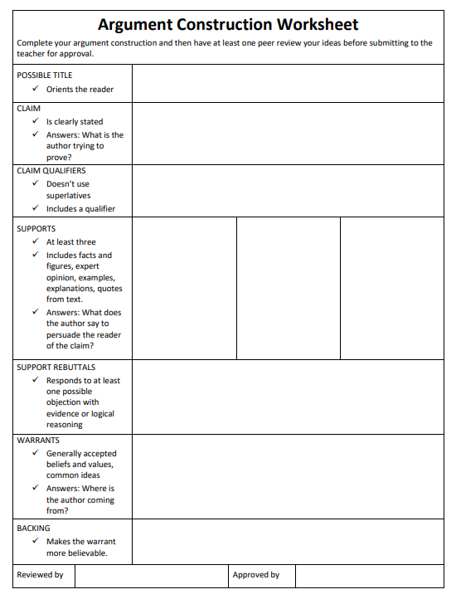
Outline Your Argument
PLAN & OUTLINE
Compose your claim.
Make sure your claim has qualifiers.
Identify three supports.
Identify at least one counterargument.
Identify any needed warrants.
Identify backing to warrant.
Compose a title for your essay.

Slide 31
Compose First Draft
COMPOSE FIRST DRAFT
Review the Argumentative Essay Rubric and Scoring Guide.
Draft your essay. It should have a minimum of five paragraphs:
Introduction (includes claim statement)
3-4 body paragraphs (one paragraph for each support statement and evidence; one paragraph for counterargument)
Conclusion (summarizes your argument and appeals to the reader’s emotions)

Slide 32
Peer Review
REVIEW & REVISE
Be useful
Be helpful
Be kind
Reviewer:
Exchange papers. Make sure you do not have your own paper.
Read the essay carefully. Make note of any spelling errors (SP), incomplete sentences (?), run-on sentences (underline), or other issues that detract from reading.
Complete the Argument Construction Worksheet to see if all elements are included. (NOTE: The writer is not allowed to share their previously completed worksheet.)
Return the essay to the writer and review what you discovered.
Writer:
Be receptive.
Thank the reviewer for their review.

Slide 33
Finalize Your Essay
EDIT & PUBLISH
Make any final revisions to your essay.
Be sure to check the Argumentative Essay Rubric and Scoring Guide to make sure you’ve met all requirements.

Slide 34
References
Go For Broke National Education Center. Hanashi Oral History Archives. “Young Kim: Tape #12.” Film dates 1999 and 2001. Go For Broke National Education Center. https://oac.cdlib.org/findaid/ark:/13030/c82f7t23/
USC Korean American Digital Archive Files. “Col. Young Oak Kim Oral History: Segment 1 and Segment 2.” https://digitallibrary.usc.edu/CS.aspx?VP3=DamView&VBID=2A3BXZ8YEZGYV&SMLS=1&RW=1163&RH=539&FR_=1&W=1164&H=539
Woo Sung Han and translated by Edward T. Chang, Unsung Hero: Colonel Young Oak Kim Story, YOK Center for Korean American Studies, 2011. Pages 360–368.
“Colonel Young Oak Kim,” a short video published by the Council of Korean Americans. https://www.youtube.com/watch?v=KvmoNQS6GOc

