Slide 1
Lesson 4
The Korean Independence Movement

Slide 2
Activity 4.1
How Was the Korean Independence Movement Impacted by Wilson’s Fourteen Points?

Slide 3
Activity 4.1 Discussion Questions
How does the timeline for Korea’s annexation by Japan and subsequent independence movement correspond to that of World War I and World War II?
What do Wilson’s Fourteen Points say about imperialism, colonialism, and self-determination?
​What was the impact of the Fourteen Points on the Korean Independence Movement?
How did the U.S. government respond to Korea’s hope of independence?

Slide 4
Japan’s Annexation of Korea
WHY? | Japan believed in the policy of imperialism, where an empire was seen as key to modernization and power. They needed more living space, resources, and slave labor. Japan also wanted to prevent Russia and the United States from controlling Korea.
WHENand HOW? | In 1910, Korea was annexed by the Empire of Japan after years of war, intimidation, and political machinations; the country was considered part of Japan until 1945. The Empire of Japan waged an all-out war on Korean culture. Schools and universities forbade speaking Korean and emphasized manual labor and loyalty to the Emperor. It became a crime to teach history from non-approved texts. Authorities burned over 200,000 Korean historical documents. During the occupation, Japan took over Korea’s labor and land. Nearly 100,000 Japanese families were given land to be settled in Korea; they chopped down trees by the millions and planted non-native species. Nearly 725,000 Korean workers were made to work in Japan.
WHY?
HOW?

Slide 5
Pivotal Events in Korea 1905-1919
World War I
June 1914: Assassination of Archduke Ferdinand
January 1917: U.S. enters WWI
January 1918: Wilson presents his 14 Points
January 1919: Paris Peace Conference
June 1919: Treaty of Versailles

Slide 6
Japan’s Actions Korea’s Objectives
SOVEREIGNTY
SELF-DETERMINATION
Sovereignty: the authority of a state to govern itself
INDEPENDENCE
ANNEXATION
Self-determination: the process by which a country determines its own statehood and forms its own allegiances and government
Annexation: forcible acquisition of one state’s territory by another state
OCCUPATION
Independence: condition of a nation in which residents and population exercise self-government over its territory
Occupation: the takeover and control of one country by another
COLONIALISM
Colonialism: acquiring control over another country, occupying it with settlers, and exploiting it economically
IMPERIALISM
Imperialism: a policy of extending a country’s power and influence through military force.

Slide 7
What Were Wilson’s Fourteen Points?
The Fourteen Points Peace Program was a statement of principles for peace that was to be used for peace negotiations to end World War I.
The principles were outlined in a January 8, 1918, speech on peace terms to the U.S. Congress by President Woodrow Wilson.
Designed as guidelines for the rebuilding of the postwar world, the points included Wilson’s ideas regarding the concept of national self-determination, with the achievement of this through the dismantling of European empires and the creation of new states.

Slide 8
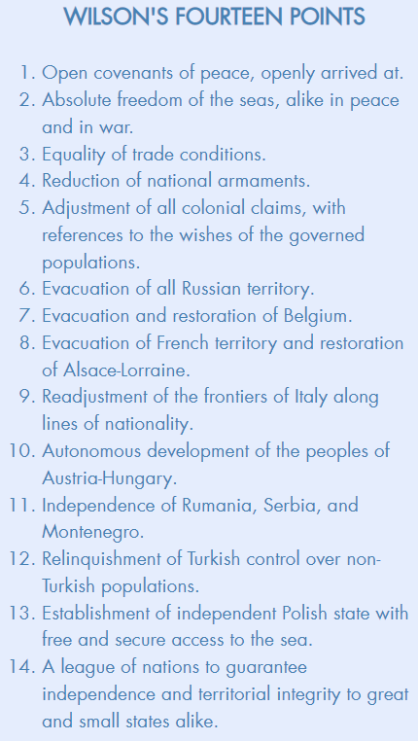
Summary of the Fourteen Points
The Fourteen Points consisted of:
8 directions on how to resolve specific territorial issues among WWI combatant nations;
5 principles for a peaceful world; and
1 plan to establish a League of Nations to enforce peace and protect all countries great and small.
Which point was of most importance to the Korean Independence Movement?
Notes:
Advance the animation with a click and point 5 will be highlighted to answer the question.

Slide 9
What Did the Fourteen Points Mean for Koreans Living Under Japanese Colonial Rule?
FULL TEXT OF POINT FIVE: A free, open-minded, and absolutely impartial adjustment of all colonial claims, based upon a strict observance of the principle that in determining all such questions of sovereignty the interests of the populations concerned must have equal weight with the equitable claims of the government whose title is to be determined.
EXCERPT FROM END OF WILSON’S SPEECH: We have spoken now, surely, in terms too concrete to admit of any further doubt or question. An evident principle runs through the whole program I have outlined. It is the principle of justice to all peoples and nationalities, and their right to live on equal terms of liberty and safety with one another, whether they be strong or weak. Unless this principle be made its foundation no part of the structure of international justice can stand. The people of the United States could act upon no other principle; and to the vindication of this principle they are ready to devote their lives, their honor, and everything that they possess. The moral climax of this the culminating and final war for human liberty has come, and they are ready to put their own strength, their own highest purpose, their own integrity and devotion to the test.

Slide 10
What Was the Korean Independence Movement?
The Korean Independence Movement was a military and diplomatic campaign to achieve the independence of Korea from Japan.
It was a four-decades-long endeavor from 1905 to 1945 by Koreans to liberate Korea from Japanese colonization.
After the Japanese annexation of Korea in 1910, Korea’s domestic resistance peaked in the March 1st Movement, which was eventually crushed and sent Korean leaders to flee into China and the U.S.
In China, Korean independence activists built ties with the National Government of the Republic of China, which supported the Provisional Government of the Republic of Korea as a government in exile.
In the U.S., Korean immigrants and Korean Americans played a vital role in the movement. They contributed money, organized patriotic activities in their communities to raise awareness, and issued appeals for support to the U.S. government. Throughout the years, and from generation to generation, Korean immigrants remained loyal to Korea’s cause for liberation.

Slide 11
How Schoolgirls Became Independence Fighters in 1919
How Schoolgirls Became Independence Fighters (4:18 minutes) Source: YouTube

Slide 12
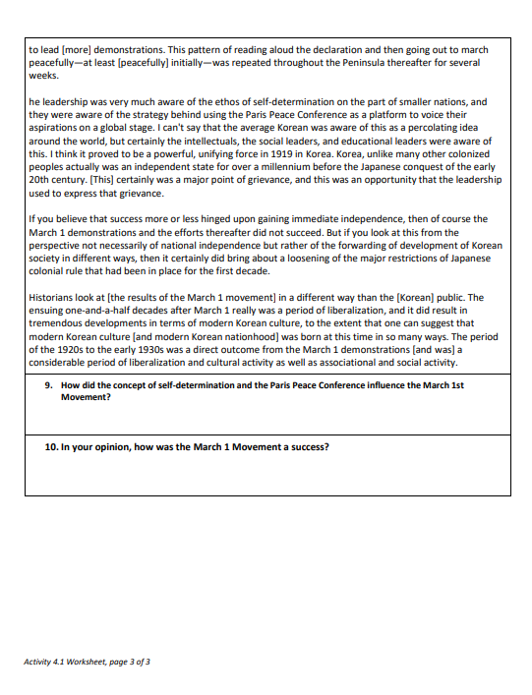
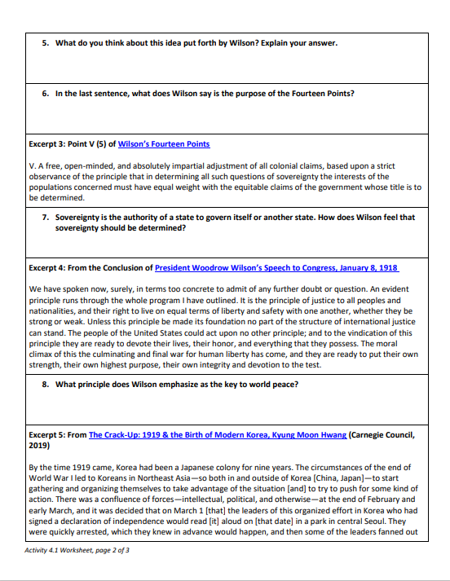
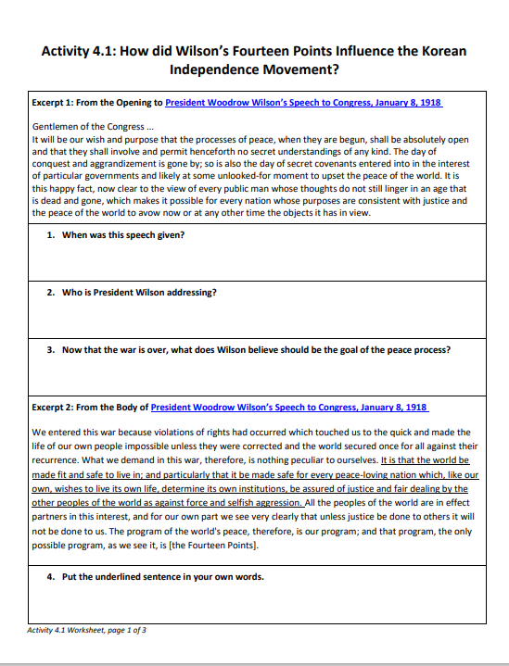
Activity 4.1
Complete the Activity 4.1 Worksheet, in which will examine Wilson’s speech and the Fourteen Points in more detail.
This might be completed individually, in pairs, or in small groups.

Slide 13
Activity 4.2
How Did the Korean Independence Movement Shape and Become Shaped by the Formation of the Korean American Identity in the United States?

Slide 14
Lesson 4.2 Discussion Questions
In the study of migration, push factors are those that encourage a population to leave its home, and pull factors are those that draw a population to another area or place. What push and pull factors shaped Korean immigration to the U.S. in the early 1900s?
How did California Alien Land Laws affect Korean immigrants?
How did early Korean Americans see Japan’s occupation of Korea?
How did the March 1st Movement shape attitudes toward Korea and Korean Americans in the United States?
Who organized the First Korean Congress and what was its purpose?
How did the Korean Independence Movement impact Korean women’s groups and contribute to the identity of Korean American women?
How did the Korean Independence Movement shape and become shaped by the formation of the Korean American identity in the United States?

Slide 15
How did the Korean Independence Movement Shape and Become Shaped by the Formation of the Korean American Identity in the United States?
KOREAN INDEPENDENCE MOVEMENT
KOREAN AMERICAN IDENTITY
In Activity 4.1, we identified how Wilson’s Fourteen Points shaped Korean thinking about independence.
In this activity, we will look at how other events and issues shaped and were shaped by the Korean Independence Movement and Korean American identity:
These events occurred in Korea and the United States and were influenced by events in countries where Koreans had immigrated.
Some seemed small at the onset but had a large influence.
Not every event is identified in this lesson.

Slide 16
Jigsaw Activity
Divide into six-member Home Groups, which should be as diverse as possible. Divide up the topics so that each member has one topic.
Our focus is the following question: How did the Korean Independence Movement shape and become shaped by the formation of the Korean American identity in the United States?
Jigsaw out to Expert Groups and examine primary sources related to a specific event or issue that shaped both the Korean Independence Movement and the Korean American identity. Answer questions for your topic and take notes. Return home as the only expert on that topic in your group.
NOTE: These events were not the only ones that shaped the Korean American identity and the Korean Independence Movement. These events were selected because they allow us to view original documents and news reports from the time.

Slide 17
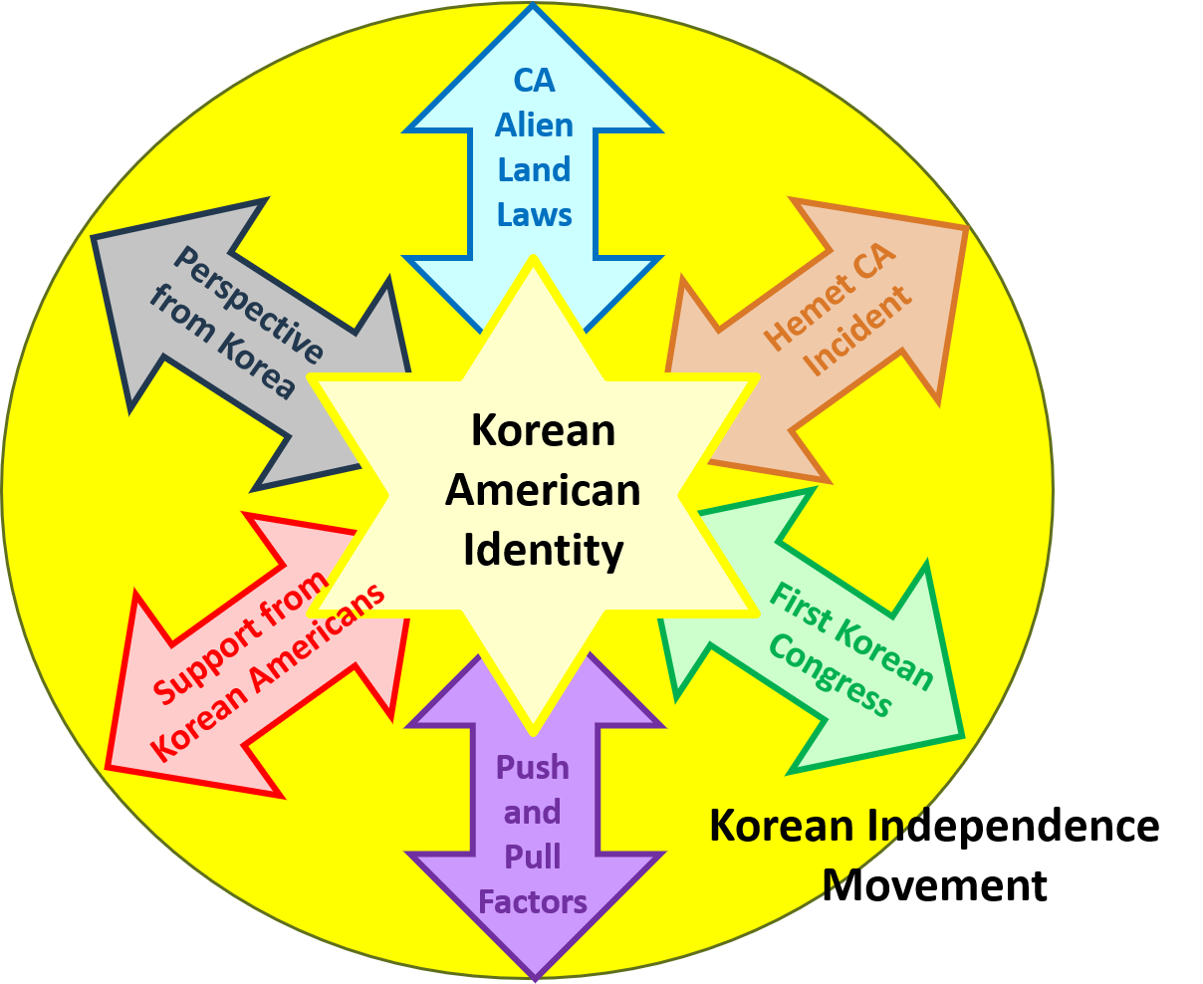
Selected Events that Shaped the Korean American Identity and Korean Independence Movement
Notes:
The center star represents the Korean American identity and the gray circle represents the Korean Independence Movement. The six arrows represent six events and issues that shaped and were shaped by these two. They are not the only events and issues.

Slide 18
Group Topics
Topic ​1: Push and Pull Factors Korean Immigration
Topic 2: California Alien Land Laws of 1913 and 1920
Topic 3: Hemet, California Incident
Topic 4: First Korean Congress in the U.S.
Topic 5: Perspectives from Korea
Topic 6: Women, Christians, and Other Contributors
Push and Pull Factors
CA Alien Land Laws
First Korean Congress
Hemet California Incident
Perspectives from Korea
Support from
Korean Americans

Slide 19
Expert Groups Assignment
In the Expert Groups, each member will:
Review 2–4 original documents related to one of the six events (documents include excerpts from first-hand accounts, oral interviews, letters, speeches, news articles, and other items).
Answer 5–7 questions and take additional notes as needed.
Be prepared to return to their Home Group to share expert knowledge and complete the assignment.

Slide 20
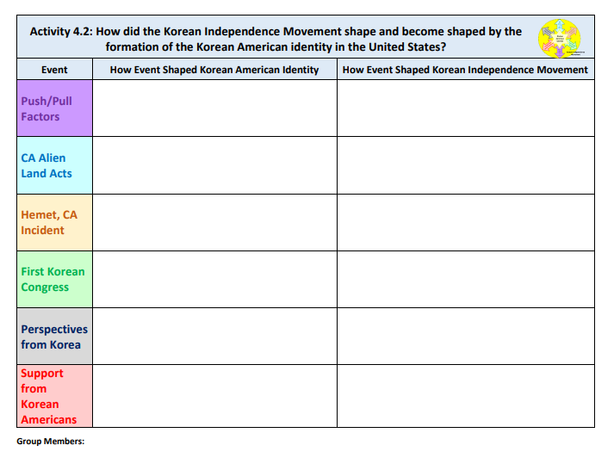
Home Group Assignment
One by one, group members should explain the documents they reviewed, identify a few interesting/critical findings, and provide their response to the final question: How did the Korean Independence Movement shape and become shaped by the formation of the Korean American identity in the United States?
The group should discuss how the event shaped and was shaped by the Korean American Iidentity and how the event shaped and was shaped by the Korean Independent Movement.
Each member of the Home Group should complete their own table.

Slide 21
Summative Assessment
Persuasive Letter

Slide 22
What Is a Persuasive Letter?
A persuasive letter is a letter written to persuade an organization or individual toward accepting the writer's issue, interest, or perspective.
Drafting letters requires students to grow as writers by articulating their opinions, supporting their ideas with solid evidence, and crafting their arguments for a target audience.
Thinking creatively about possible solutions to real problems helps students understand their agency to affect change.

Slide 23
Persuasive Letter
Writing Prompt: Imagine you are a Korean schoolgirl who participated in the Korean Independence Movement in 1919.
Compose a letter to President Wilson, asking the U.S. to take a position in favor of Korean independence. Some arguments or points you might connect to in your letter:
The Fourteen Points speech and notion of self-determination
The devastation of World War I
Global advocacy and organization for Korean independence by Koreans living in the United States, Korea, China, Russia, and Mexico
Japan’s colonization of Korea and violation of principles of the Fourteen Points

Slide 24
Persuasive Letter Scoring Rubric
CATEGORY | Exceeds Standard (A) | Meets Standard (B-C) | Does Not Meet Standard (D-F)
Subject Line | Strongly and clearly states a personal opinion. Clearly identifies the issue. | Clearly states a personal opinion. Some references to the issue. | Personal opinion is not clearly stated. Little or no references to the issue; issue is unclear.
Reasons and Support | Three or more excellent points are made with good support. It is evident the writer put much thought and research into this assignment. | Three or more points are made with support, but the arguments are somewhat weak in places. The writer doesn’t persuade completely. | Preparation is weak; arguments are weak or missing; and fewer than three points are made.
Conclusion | Summarizes personal opinion in a strong concluding statement. | Summarizes personal opinion in a concluding statement. | Concluding statement is missing or is a weak summary of personal opinion.
Organization | Sentences and paragraphs are complete, well written, and varied. | Sentence and paragraph structure is generally correct. | Sentence and paragraph structure is inconsistent.
Word Choice and Tone | Choice of words that are clear, descriptive, and accurate. Maintains consistent persuasive tone throughout letter. Respectful in tone. | Adequate choice of words that are clear and descriptive. Demonstrates a persuasive tone in parts of the letter. Respectful in tone. | Choice of words that are unclear and not descriptive. Tone is informal.
Grammar and Spelling | Contains few, if any, errors in punctuation, spelling, or grammar. | Contains several errors in punctuation, spelling, or grammar that do not interfere with meaning. | Contains many errors in punctuation, spelling, or grammar that interfere with meaning.

Slide 25
Writing Extension
Expository Essay

Slide 26
Writing Activity
Quick-Write Closing Activity
Respond to the following prompt:
Explain which of the issues/events you feel had the biggest impact on the Korean American identity. Use these questions to guide your response: • What happened during the event/issue you selected? • How did it impact the Korean Independence Movement? • How did it impact the formation of the Korean American identity?
Essay Question for Exam
Many events and issues impacted the formation of the Korean American identity. Identify at least five and explain how they influenced Korean American identity formation.

