Slide 1
Lesson 2
The First Koreatown and the Legacy of Dosan Ahn Chang Ho

Slide 2
Discussion Questions
What were characteristics of the first Koreatown in Riverside, California?
Who was Dosan Ahn Chang Ho?
What was life like for immigrant and women workers in the early California citrus industry?
What contributions did Dosan make to California and the United States?
What contributions did he make to the Korean American community?
What contributions did he make to Korea?

Slide 3
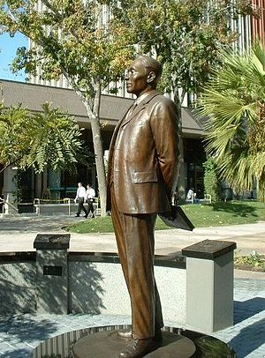
Dosan Ahn Chang Ho Memorial
This is a memorial statue of Dosan Ahn Chang Ho.
Where is this statue located?
TIP: Look for clues in the images.
Short Video of the Memorial
Dosan Ahn Chang Ho Memorial Source: Wikipedia

Slide 4
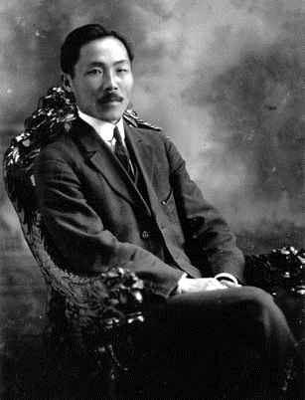
Who Was Dosan Ahn Chang Ho?
Dosan was a Korean independence activist and one of the early leaders of the Korean American immigrant community in the United States.
He was born in 1878, in Kangso County, Pyongan province, in present-day South Pyongan, North Korea.
He immigrated to the United States in 1902.
In October 1902, he came to San Francisco with his wife Helen (Hye Ryeon Lee) to pursue a better education. They were the first married couple to come from Korea to the United States.
He founded the Friendship Society (Chinmoke Hoe) in 1903, the first group that was organized exclusively for Koreans in the United States.
Dosan Ahn Chang Ho in Los Angeles Source: Wikipedia

Slide 5
Why Settle in Riverside?
Anti-Asian attitudes in San Francisco
Economic opportunities in Riverside due to large citrus industry

Slide 6
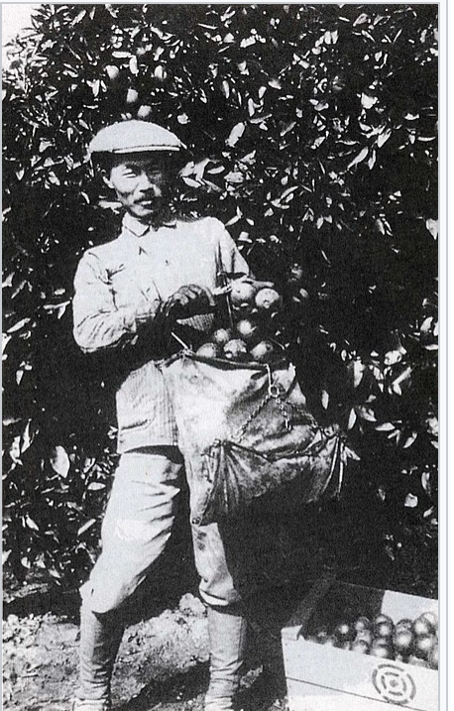
Life in Riverside
Koreans worked as migrant farm workers and did domestic work (cooking, cleaning, yard work).
Dosan was a domestic worker and farm worker.
Agricultural workers were hired through labor contractors.
April 1905: Dosan opened the Korean Employment/Labor Bureau (KLB); as a labor contractor, the KLB facilitated employment and helped bring Koreans to Riverside.
Dosan Ahn Chang Ho picking oranges in Southern California, circa 1910 (Source: Wikipedia)

Slide 7
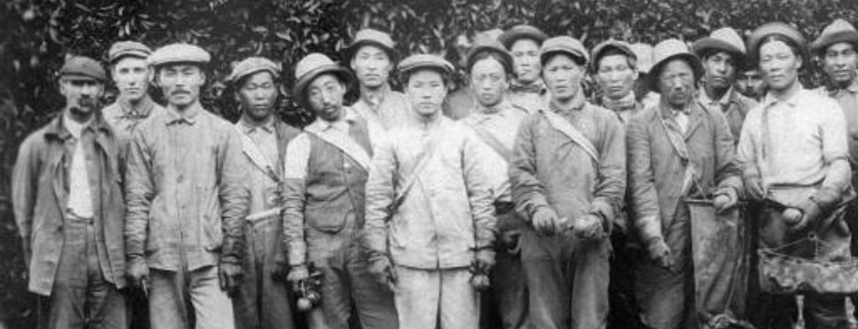
Pachappa Camp: 1905–1913
First organized Korean settlement
Founded by Dosan Ahn Chang Ho
Self-governing
Organized and run by Koreans
Family-based community
1905 Gongnip Hyophoe formed
Headquartered in San Francisco
Purpose: promote democracy and ultimately have a democratic Korea
By 1907, 200 residents lived at Pachappa Camp
Ahn Chang Ho, Kap Suk Cho, and other workers at an orange orchard in Riverside, California, in the early 1900s. Source: Courtesy of Korean Heritage Library, University of Southern California

Slide 8
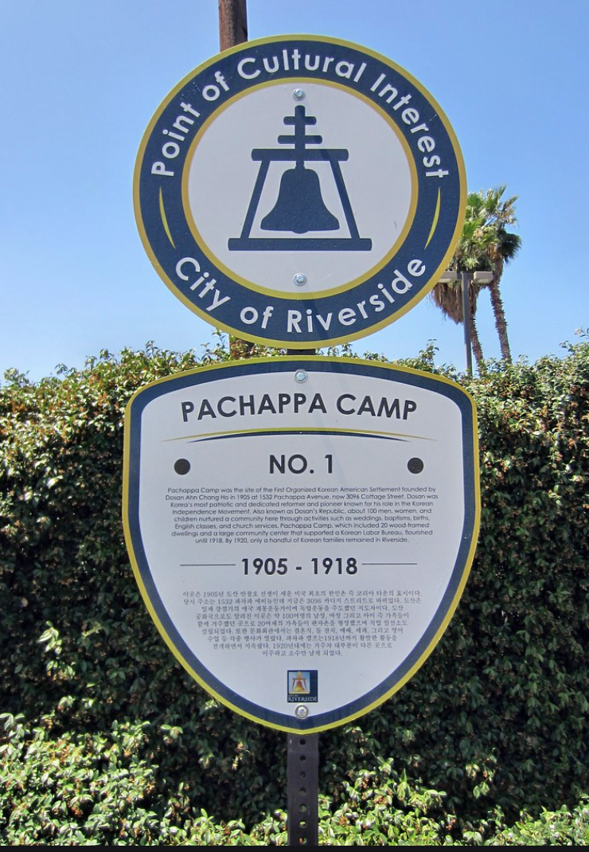
The First Koreatown: Pachappa Camp, Riverside, CA
Pachappa Camp map. Photo courtesy of Sanborn Insurance Co. of New York.

Slide 9
Life for Citrus Pickers in Early California
RESEARCH DEEPER: Many different immigrant groups (Chinese, Korean, Mexican) and women worked in the California citrus industry. What were the similarities and differences in the experiences of these groups?
The Roots of Inequality: The Citrus Industry Prospered on the Back of Segregated Immigrant Labor (Fullerton Observer, 2019)
A Woman’s World: A History of Female Labor in Citrus Packinghouses (Sweet and Sour Citrus.org)
Excerpt from Pachappa Camp: The First Koreatown in the United States (Edward T. Chang, 2021)

Slide 10
Activity: Similarities and Differences
Read your assigned article.
Make a list of characteristics of life as a worker in the California citrus industry from 1900 to 1930.
Share your findings in your small group and complete the Venn diagram of your findings. Make sure you have at least one similarity for each of the four intersections.
Be prepared to share.
Koreans
Women
Mexicans

Slide 11
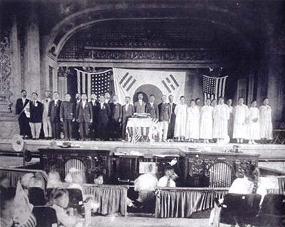
Dosan’s Efforts to Support Korean Independence
1909: Dosan and other Koreans created the Korean National Association (KNA)
Goal: to promote Korean independence from Japan
Chapters established across the U.S. and Mexico
Dosan traveled to Mexico, China, Russia, England, and the United States to promote Korean independence and set up chapters of the KNA
1913: His family moved to Los Angeles
1919: Helped establish Korean provisional government in Shanghai
National Association Annual Convention, 1915 Source: Wikipedia

Slide 12
What Was Dosan Fighting For?
In 1910, Korea was annexed by the Empire of Japan after years of war, intimidation, and political machinations; the country would be considered a part of Japan until 1945.
To establish control over its new protectorate, the Empire of Japan waged an all-out war on Korean culture.
Dosan engaged in anti-Japanese activities and promoted Korean independence.

Slide 13
Dosan’s Deportation
Deportation and removal from the United States occurs when the U.S. government orders a person to leave the country.
1924: Dosan was accused of being a Bolshevik through an anonymous letter.
1925: He was investigated and interrogated by the Department of Immigration.
1926: He was deported from San Francisco.
Arirang News (34 seconds)

Slide 14
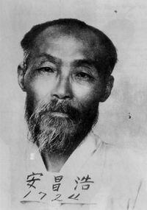
Dosan’s Later Life
1926: Dosan was deported from the U.S.
His family remained in America.
He continued to travel to promote Korean independence.
He was accused of anti-Japanese activities.
1932: Dosan was arrested in China and extradited back to Korea.
He was convicted of violating Japan's "Preservation of Peace Laws" and sentenced to 5 years in Taejon prison.
He was tortured and abused.
Japanese authorities feared he would die in prison and released him.
1938: Dosan died in March 1938 at the Korea National University Hospital.
Dosan Ahn Chang Ho, 1937 Source: Wikipedia

Slide 15
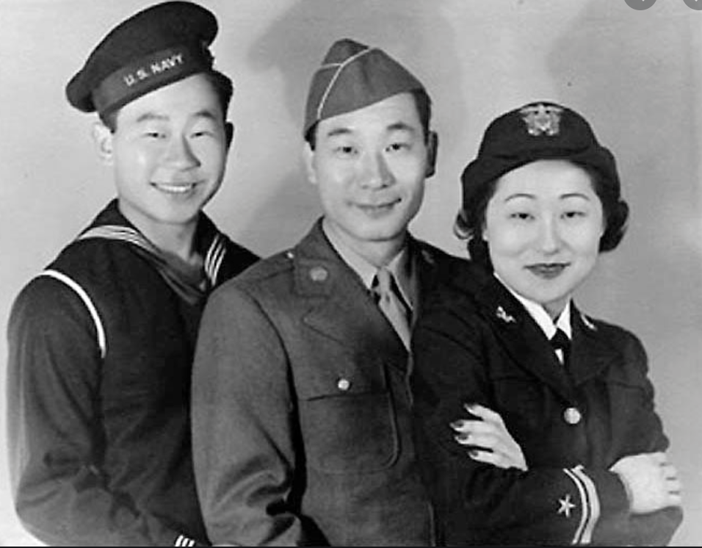
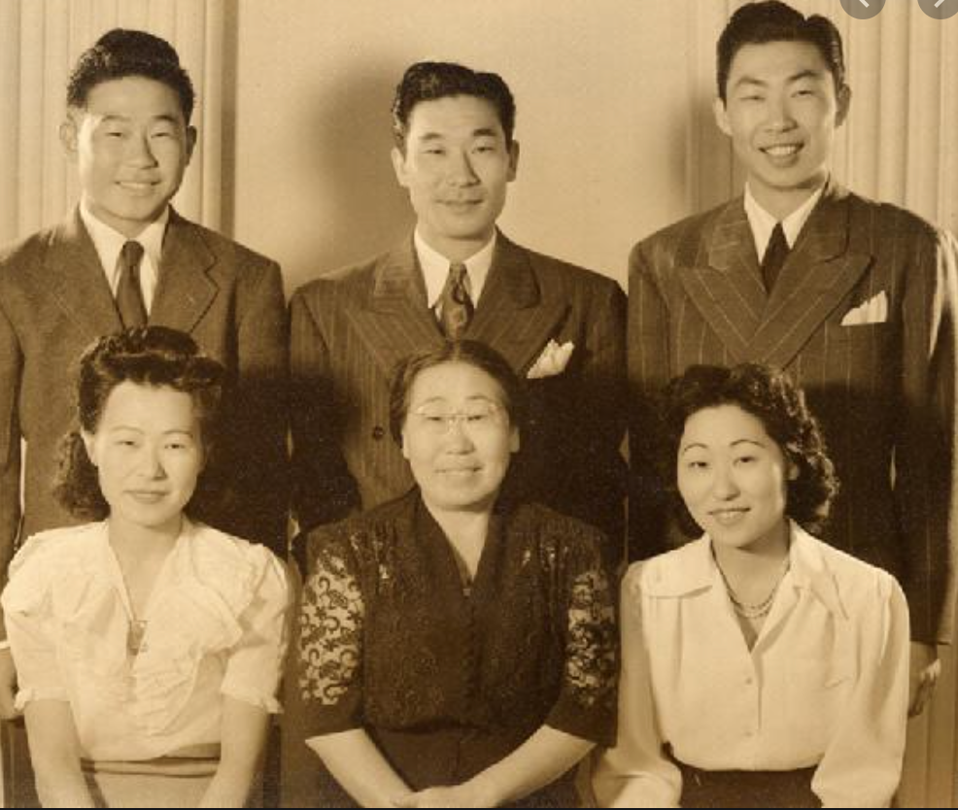
Family Legacy
Five children: Phillip, Philson, Susan, Soorah, and Ralph
Phillip, Ralph, and Susan were in the U.S. Armed Forces during WW2.
Susan Ahn Cuddy was the first female gunnery officer in the U.S. Navy.
Phillip Ahn was a TV actor.

Slide 16
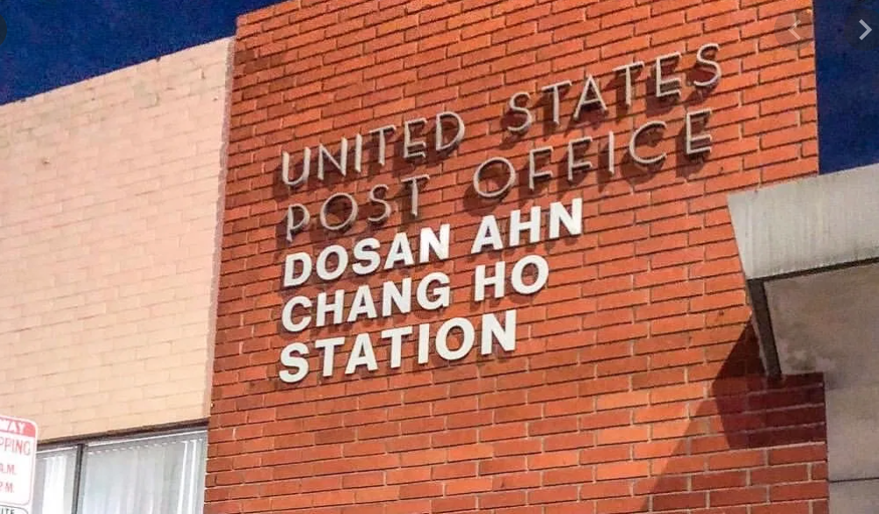
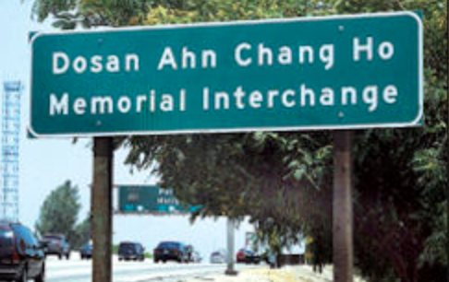
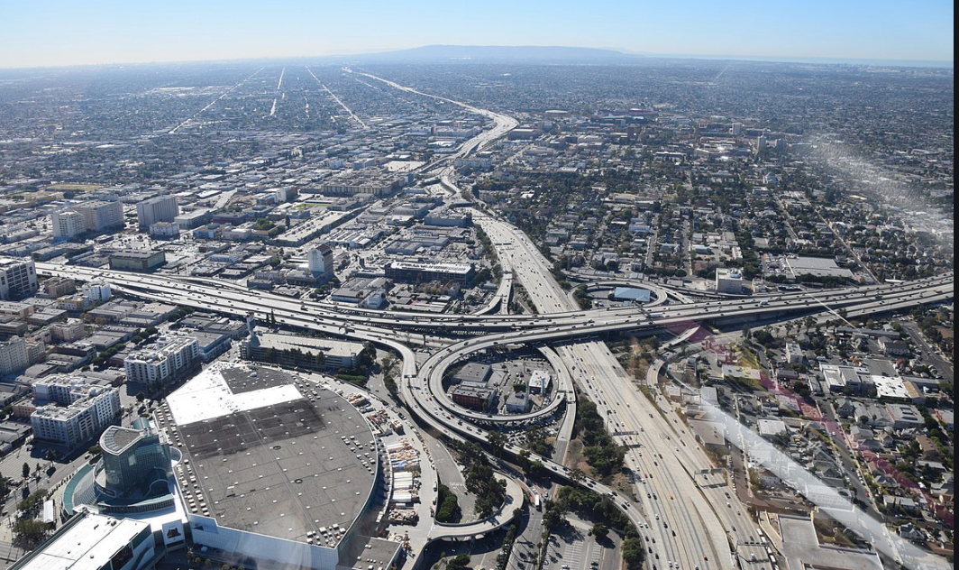
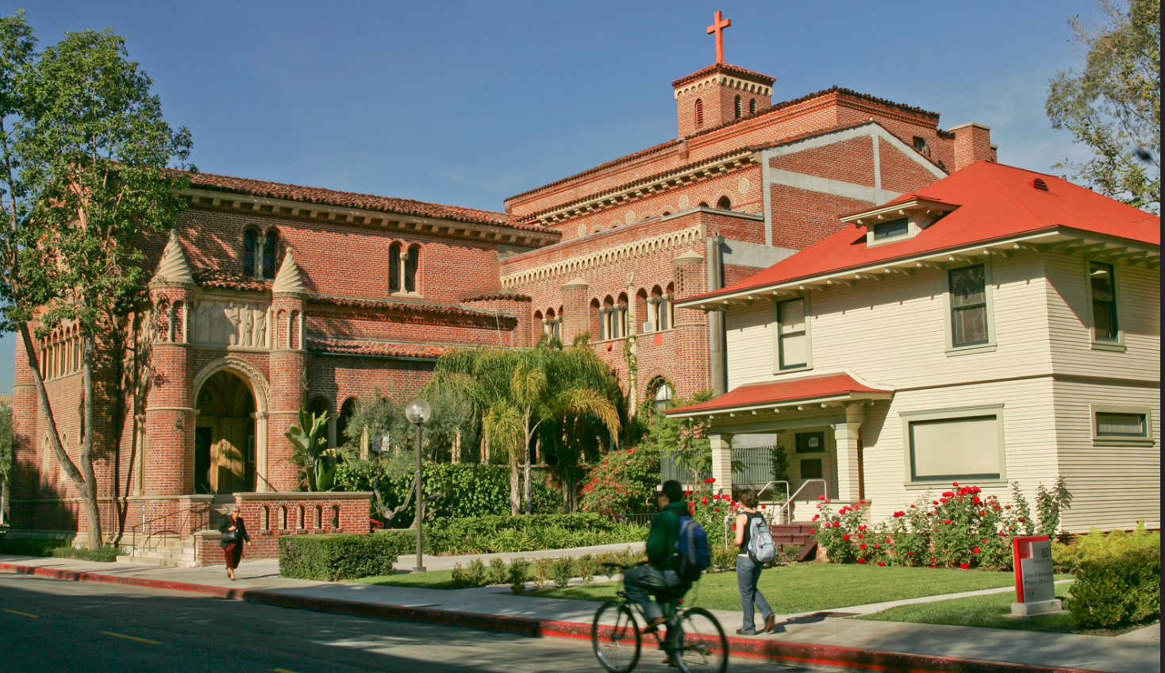
Legacy
USC Ahn House
Memorial in Korea
Dosan Ahn Chang Ho Memorial Interchange: freeway interchange at Harbor and Santa Monica freeways at the southern edge of downtown Los Angeles
Memorial in Riverside
U.S. Post Office, Dosan Ahn Chang Ho Station, in Los Angeles
Ahn House at USC

Slide 17
Quick-Write
There are many memorials of Dosan Ahn Chang Ho. Write for 5 minutes about why he is so revered in the United States and Korea. Use these questions to guide your response:
Who was Dosan Ahn Chang Ho?
What contributions did he make to California and the United States?
What contributions did he make to the Korean American community?
What contributions did he make to Korea?
Be prepared to submit your Quick-Writes and to share your ideas with the class.

Slide 18
Activity 2.2
Civic Engagement/Service Learning Project

Slide 19
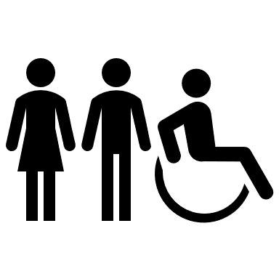
What are some needs of your community?
YOUTH
JOBS
TRAINING
MENTORS
HOUSING
Medical
FINANCIAL ASSISTANCE
Transportation
FOUR TYPES OF COMMUNITY NEEDS
PERCEIVED NEEDS | EXPRESSED NEEDS | ABSOLUTE NEEDS | RELATIVE NEEDS
Needs based on what the individuals feel their needs are | Needs defined by the number of individuals who seek help | Needs deemed universal, including water, food, and shelter | Needs rendered necessary based on equity

Slide 20
What Is Civic Engagement?
One useful definition of civic engagement is the following: individual and collective actions designed to identify and address issues of public concern.
Civic engagement can take many forms, from individual voluntarism to organizational involvement to electoral participation.
Four Constructs of Civic Engagement
Civic Action: participation in activities such as volunteering to help better the community
Civic Duty: willingness to make a positive contribution to society
Civic Skills: the ability to be involved in civil society and democracy
Social Cohesion: a sense of reciprocity, trust, and bonding to others
Categories of civic participation: political engagement, community engagement, civic skills engagement, and social justice engagement.

Slide 21
Civic Engagement Project
You may work individually or in small groups. Regardless of group size, students must each submit their own reports.
Each student must participate in at least 10 hours of civic engagement activities, excluding research and composing your report. Group members may participate in civic engagement synchronously or asynchronously.
Prior to participation in civic engagement activities, student projects must be approved by the instructor and parents (if student is under 18). In addition, an approved adult must be present at and supervise all activities.
Civic engagement activities should not compromise required school activities.

Slide 22
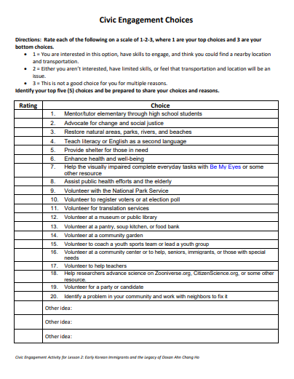
Step 0: Interests
Determine Your Choices
Individually, complete the Civic Engagement Choices and identify your top 5 choices.
Share your top choices with classmates to find a small group with common interests.

Slide 23
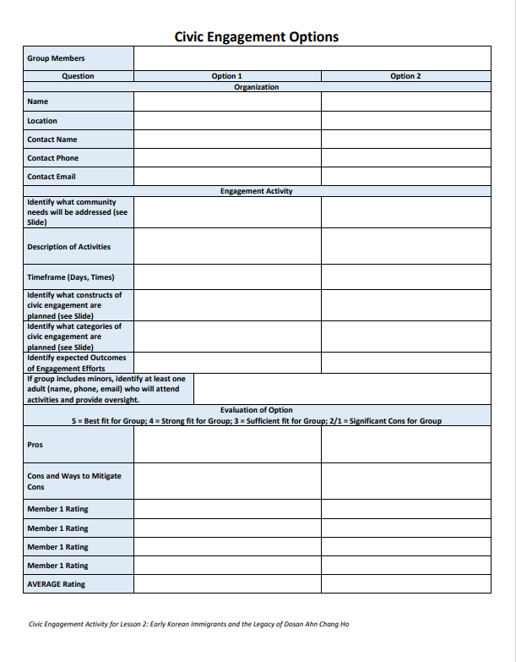
Step 1: Research
Determine Your Options
In your small groups, research ideas and identify at least two different community service projects that would be best suited for 10 hours per group member.
Complete the Civic Engagement Options worksheet.
Submit the Civic Engagement Options worksheet for teacher approval before you start the activities.

Slide 24
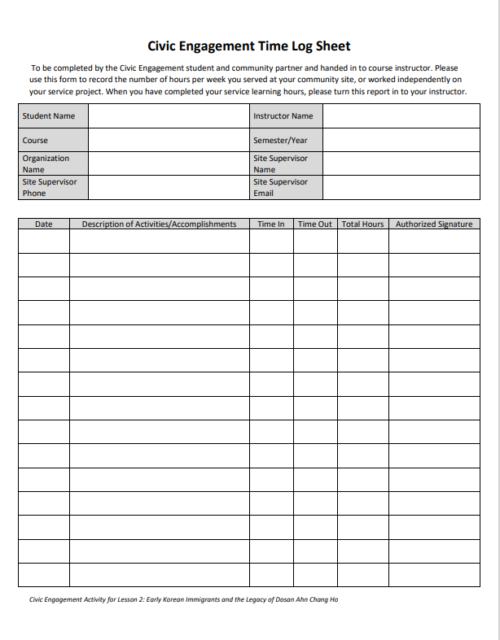
Step 2: Action
Your teacher (and parents, if minors are involved) must approve your plan before you can complete any activities.
Complete your civic engagement activities. Take pictures (make sure there are no faces of minors in your images).
Track your activities on the Civic Engagement Time Log Sheet.
Keep track also of the number of other individuals involved in the activities and any totals (i.e., how many third-grade students were present, how many bags of trash you picked up, how many voters you registered, etc.)

Slide 25
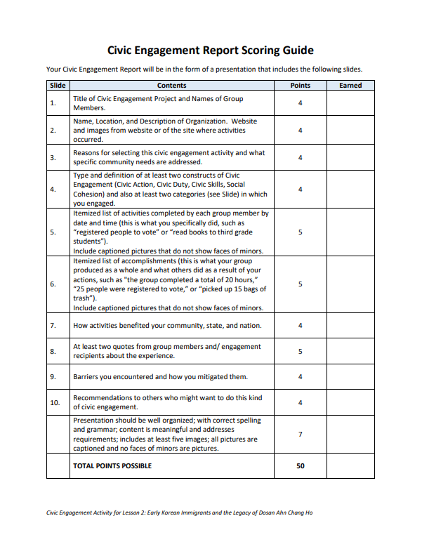
Step 3: Report
Complete the Civic Engagement Report and prepare to present your report to the class.
Follow the Civic Engagement Report Scoring Guide to earn full credit.

Slide 26
References
Chang, Edward T. and Brown, Hannah. (2018). Pachappa Camp.
Chang, Edward T. and Park, Carol K. (2019). Korean Americans, A Concise History. The Young Oak Kim Center for Korean American Studies at the University of California Riverside.

