Slide 1
Lesson 1
The Korean Diaspora and Korean Americans

Slide 2
Activity 1.1
What Is the Korean Diaspora?

Slide 3
Activity 1.1 Questions
What are characteristics of a diaspora?
What is the Korean diaspora?
Why did Koreans leave their country and disperse around the globe?
Why did Koreans immigrate to the United States?
How have reasons for Korean immigration to the United States changed over time?

Slide 4
What Is a Diaspora?
Diaspora: populations, such as members of an ethnic or religious group, that originated from the same place but dispersed to different locations.
A diaspora population is a group migrants, or descendants of migrants, whose identity and sense of belonging have been shaped by their migration experience and background.
Characteristics of Diasporas
Migration | Collective Memory | Connection | Group Consciousness | Kinship
Migration from a country of origin in search of work or to escape conflict | An idealized collective memory about the ancestral home | A continuing connection to country of origin | A strong group consciousness | A sense of kinship with diaspora members in other countries

Slide 5
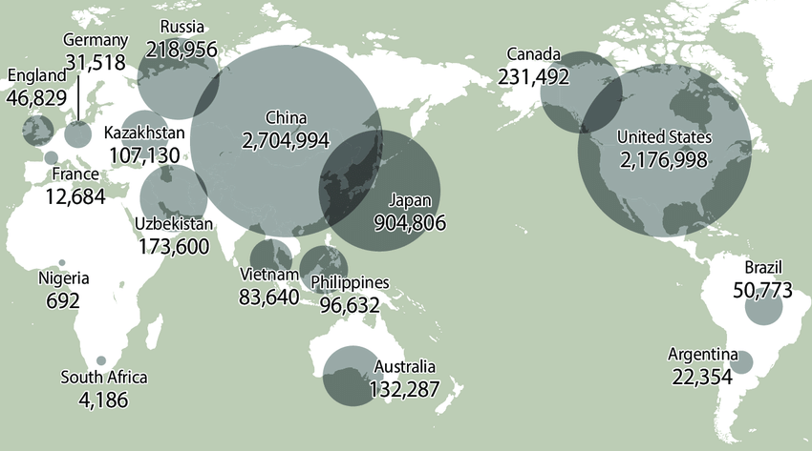
Koreans Across the Globe, 2011
Source: "World's widest diaspora born over 100 years ago." Korea Joongang Daily, October 2, 2013.
This is the Korean diaspora.

Slide 6
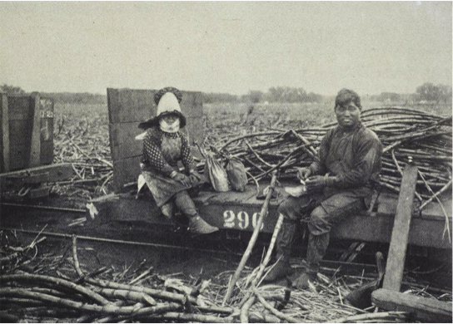
First Wave of Korean Immigrants: 1903~1949*
The immigration of Koreans can be largely divided into three periods:
First wave from 1903 to 1949
Second wave from 1950 to 1964
Contemporary period
1898: Hawaii was annexed by the United States; plantation owners in Hawaii needed cheap labor
1903: First shipload of Korean immigrants arrived in Hawaii to work on pineapple and sugar plantations (Chinese Exclusion Act banned Chinese laborers)
1905: More than 7,226 Koreans had come to Hawaii (637 women; 465 children) to escape the famines and turbulent political climate of Korea
Korean Immigrants in Hawaii (Source: Chung, S. History of Korean Immigration to America, from 1903 to Present, Boston University)
*Adapted from Chung, S. History of Korean Immigration to America, from 1903 to Present (Boston University)

Slide 7
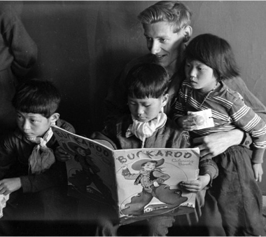
Second Wave of Korean Immigrants: 1950~1964
After Korea was liberated from Japan’s annexation in 1945, Korea became a battleground in the power struggle between the United States and the Soviet Union.
Three groups of immigrants:
Korean wives of American soldiers so-called “war brides”
Isolated from both Korean and American communities because most were required to stay on military bases or in military facilities
Korean war orphans adopted by American families
“GI babies”—fathered by American servicemen—experienced a triple stigma: they were mixed-race, they were fatherless, and their mothers were treated as prostitutes who had borne racially “impure” babies
Korean War orphans. (Source: Chung, S. History of Korean Immigration to America, from 1903 to Present , Boston University)
27,000 people composed of students, businessmen, and intellectual professionals who were medical doctors, lawyers, and professors
Although not completely free from segregation and racism, these Korean immigrants were well accepted and integrated into the American society, becoming the “Model Minority”.

Slide 8
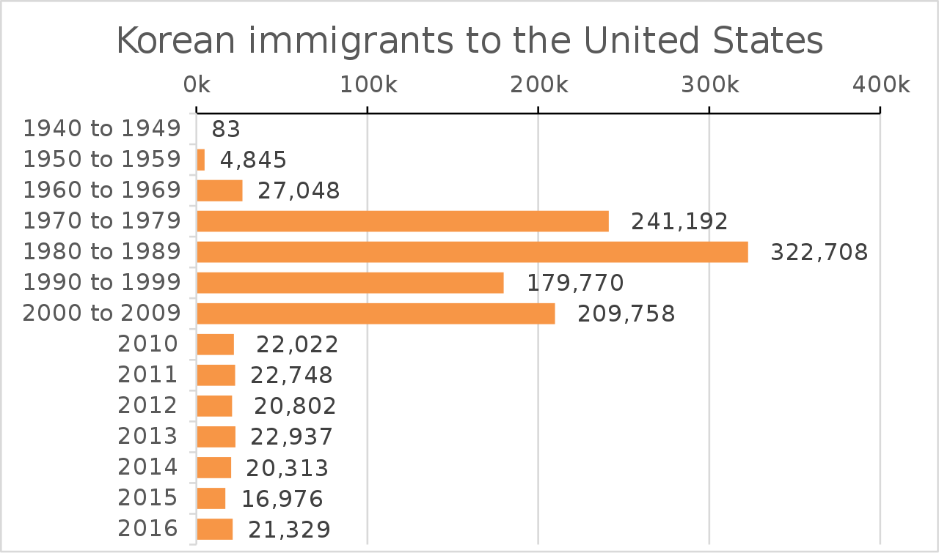
Third Wave of Korean Immigrants (1965-present)
The 1965 Immigration and Naturalization Act revoked the national quota system and made family reunification possible.
U.S. lifted quota system and recruited experts and professionals from Asia, along with families.
The annual number of Korean immigrants steadily increased beginning in 1965, and the 30,000 mark was reached in 1976.
From 1976 to 1990, the Korean diaspora community was the largest group of immigrants.
Unlike the first and second wave of immigrants who were mostly laborers, war victims, or political refugees who had no choice but to immigrate, these Korean immigrants were white-collar workers in Korea who voluntarily moved to America.
North and South Koreans obtaining lawful permanent resident status: 1940-2016

Slide 9
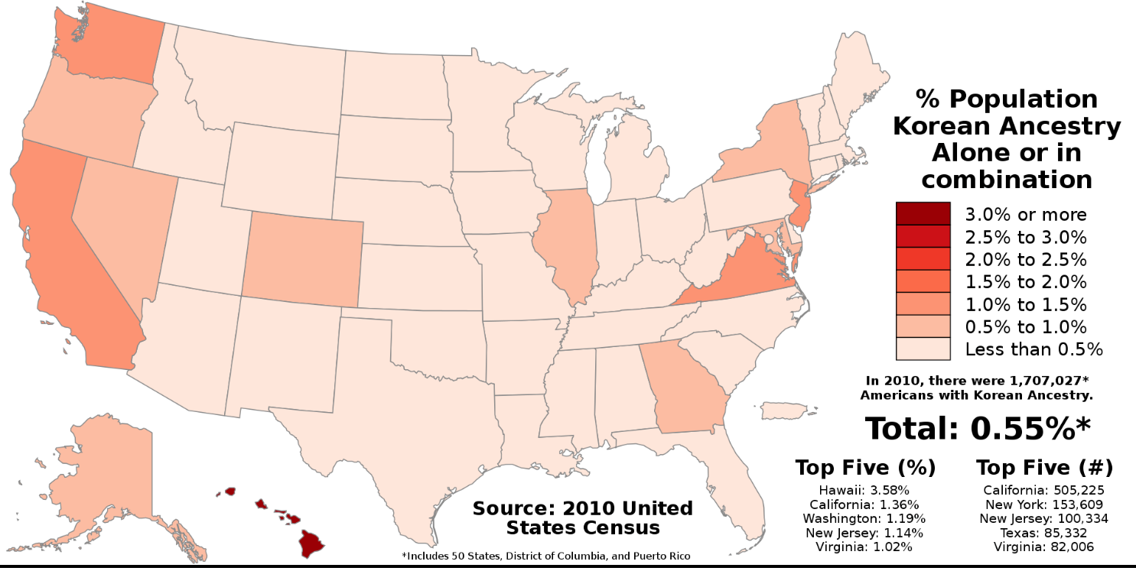
U.S. Korean American Population by State
As of 2023, the United States has the following distributions of Korean Americans:
In CA, there are 558,338 Korean Americans.
New York has a Korean American population of 141, 745
Texas is home to 115,107 Korean Americans

Slide 10
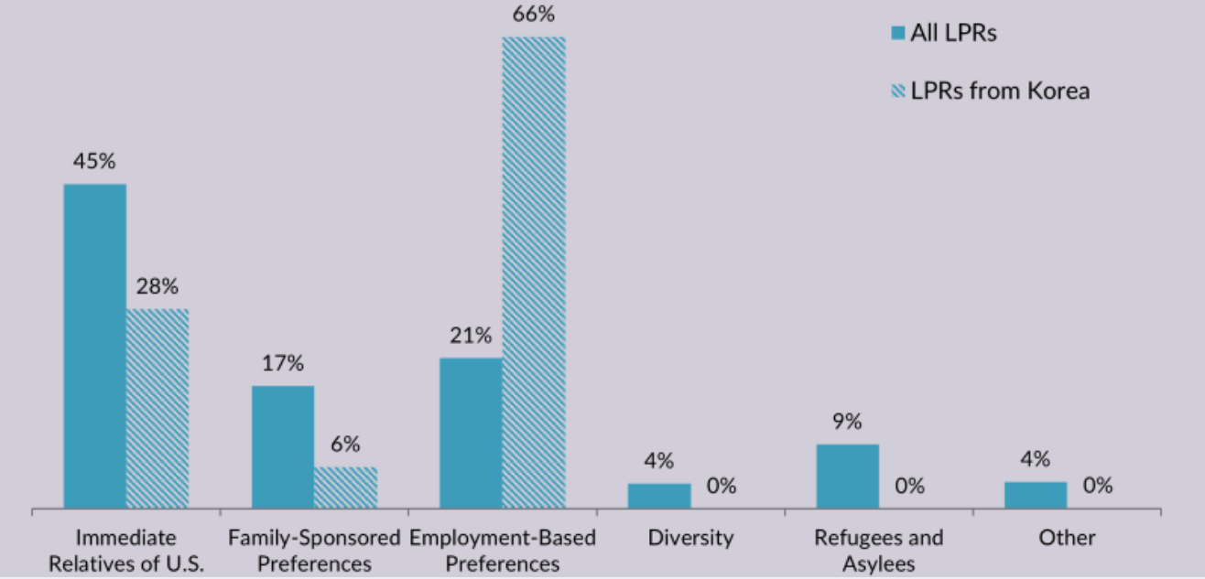
Immigration Pathways
In 2019, of the more than 1 million Korean immigrants in the United States:
66% (nearly 689,000) were naturalized citizens
61% of all Korean immigrants entered the United States before 2000
22% arrived between 2000 and 2009
18% entered after 2010
In 2020, more than 16,200 Korean immigrants became lawful permanent residents (LPRs). Most were sponsored by employers or immediate relatives.
Immigration Pathways of Korean Americans and All Immigrants in the U.S., 2019 (Source: MPI tabulation of data from Department of Homeland Security (DHS), 2017 Yearbook of Immigration Statistics (Washington, DC: DHS Office of Immigration Statistics, 2020)

Slide 11
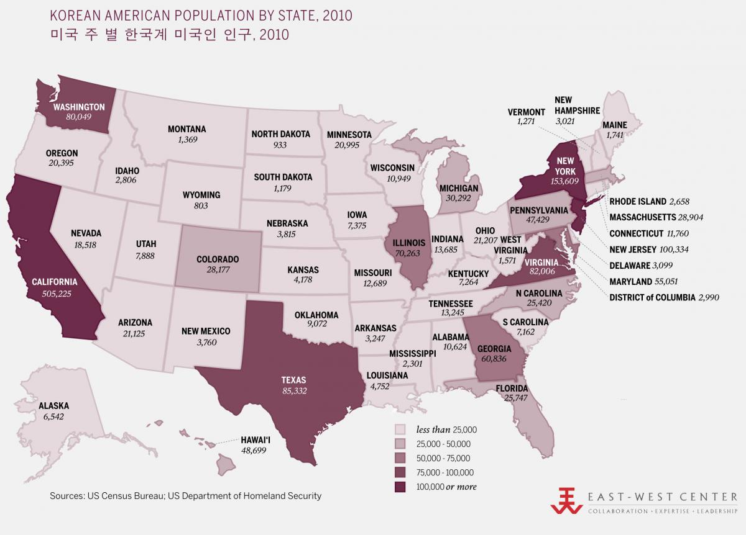
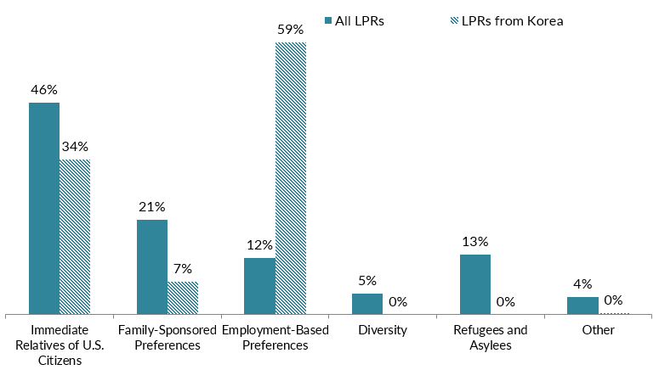
Activity 1.1: The Korean Diaspora: Interpreting Graphs and Charts
In this activity, you will use three charts and graphs to learn more about the Korean diaspora and Korean Americans in the United States.

Slide 12
Activity 1.2
Who are Korean Americans?
Why did they leave Korea and come to the United States?

Slide 13
Activity 1.2 Questions
Who are Korean Americans?
Why did they leave Korea and come to the United States?
What was life like for the Koreans who immigrated to Hawaii?
How were Korean immigrants treated during World War I and World War II?
What was life like for Korean immigrants in the second wave?
How have Korean immigrant experiences changed since 1903?

Slide 14
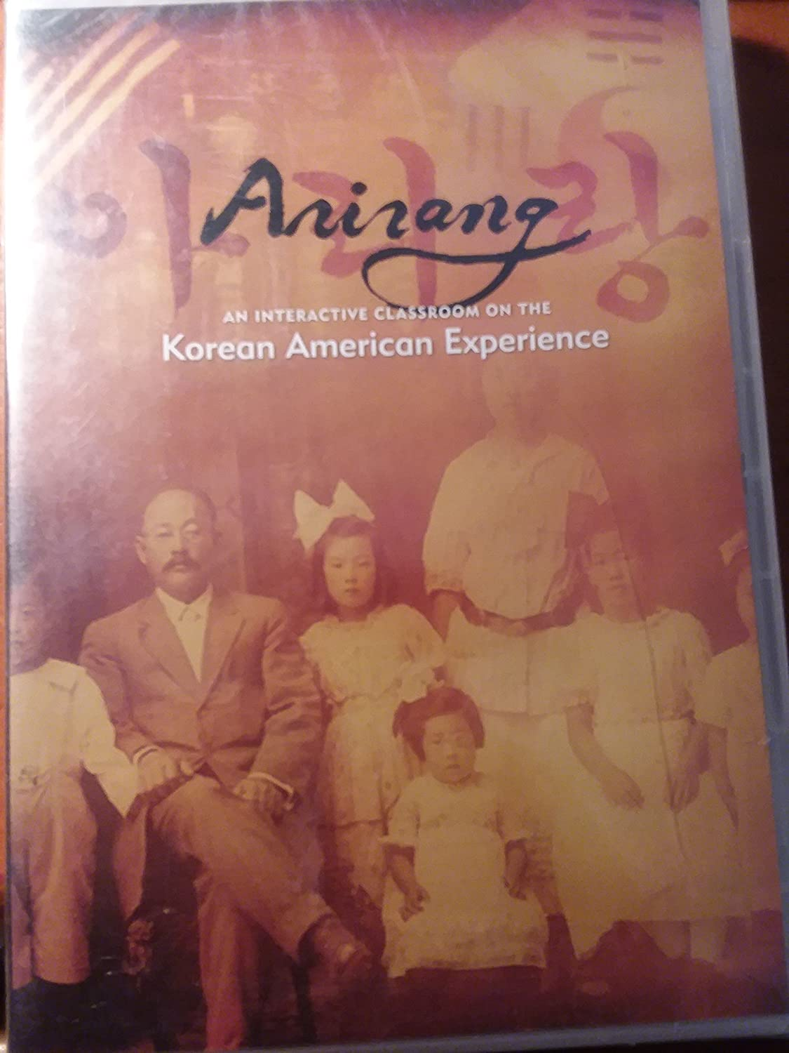
Arirang: The Korean American Journey and The Korean American Dream (112 min)
Compelling and moving documentary: Part 1 & Part 2
Begins with journey of 7,000+ Koreans from their homeland to new lives on sugar plantations of Hawaii
Continues with dramatic renewal of migration to America as a result of the Korean War, and subsequent changes in U.S. immigration law
Captures a segment of society that has risen from humble beginnings to national prominence, through their devotion to hard work and their community
Source: Amazon
Producer Tom Coffman has created a dramatic documentary that covers the background of political forces in Korea that drove immigrants overseas, their arrival in Hawaii 100 years ago, and work by political leaders in exile to restore sovereignty. Available on YouTube, Amazon, and the Center for Asian American Media (CAAM).

Slide 15
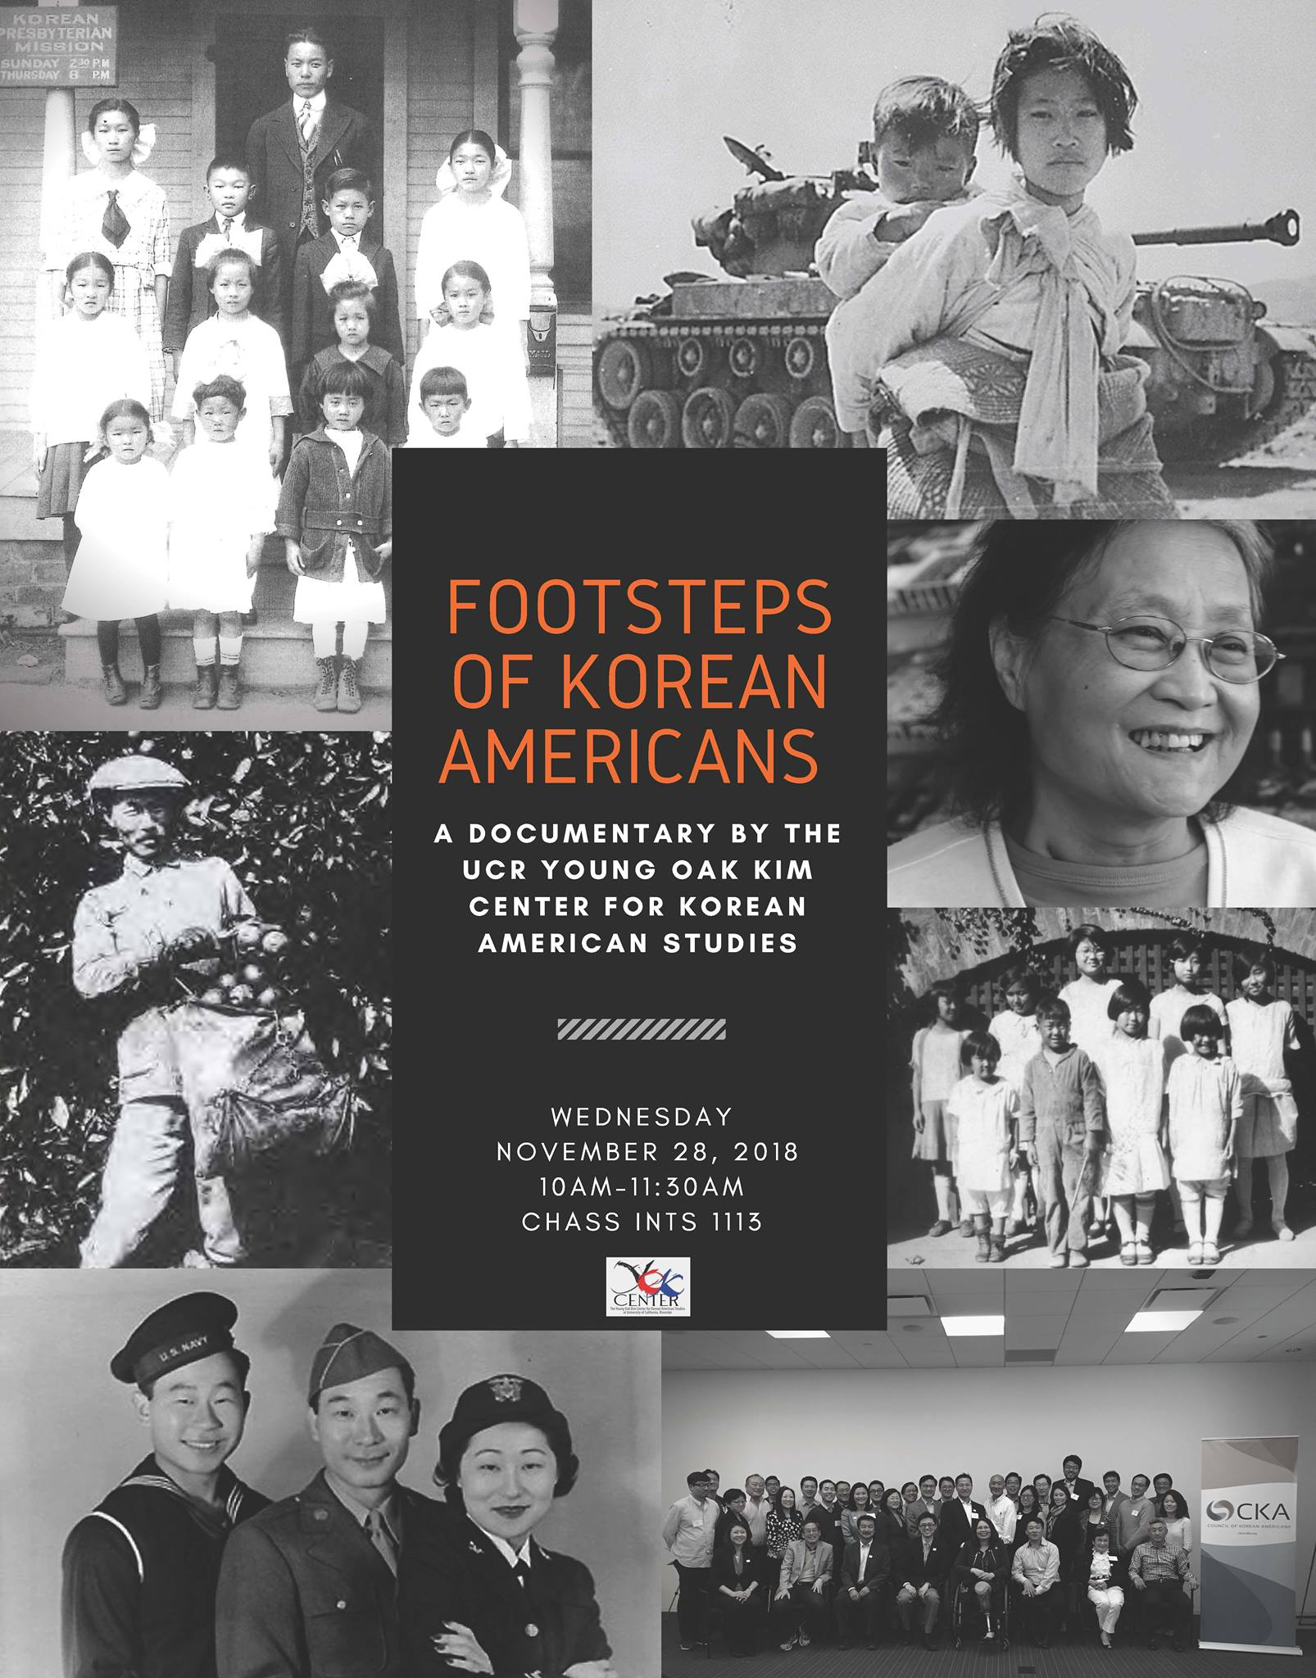
Footsteps of Korean Americans (37 min)
Footsteps of Korean Americans is a short documentary written by Prof. Edward T. Chang and Carol K. Park and produced by the YOK Center, UC Riverside, with the generous support of the Academy of Korean Studies.
This short documentary covers Korean American history and is a companion video to the textbook, Korean Americans: A Concise History.
Source: Flyer for film screening of the "Footsteps of Korean Americans", University of California, Riverside.

Slide 16
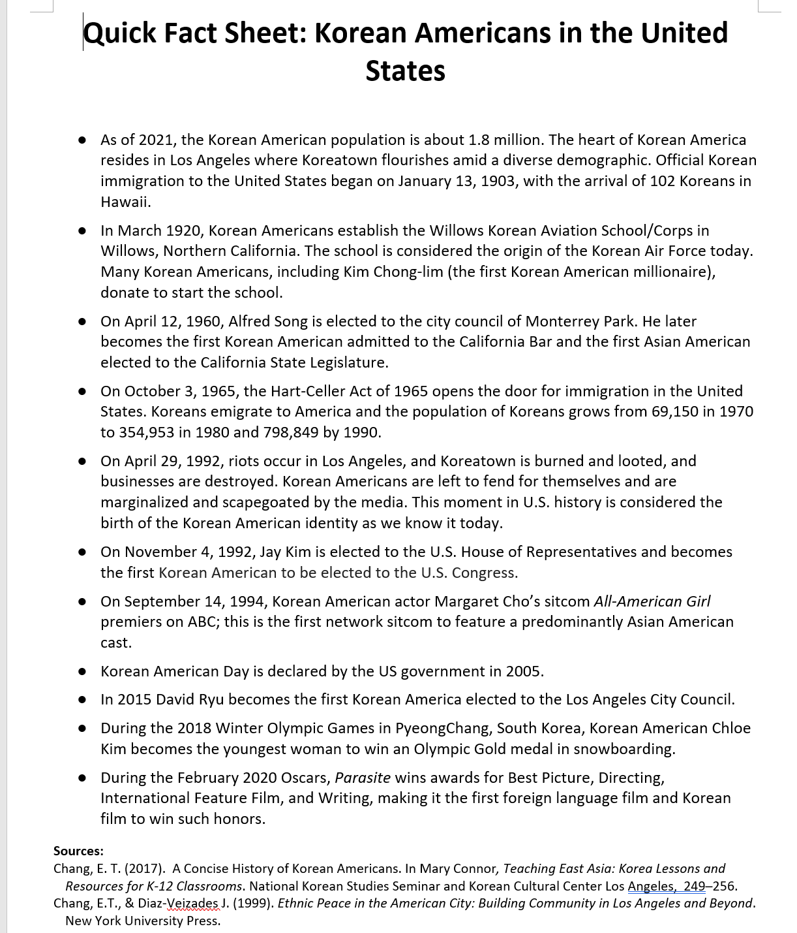
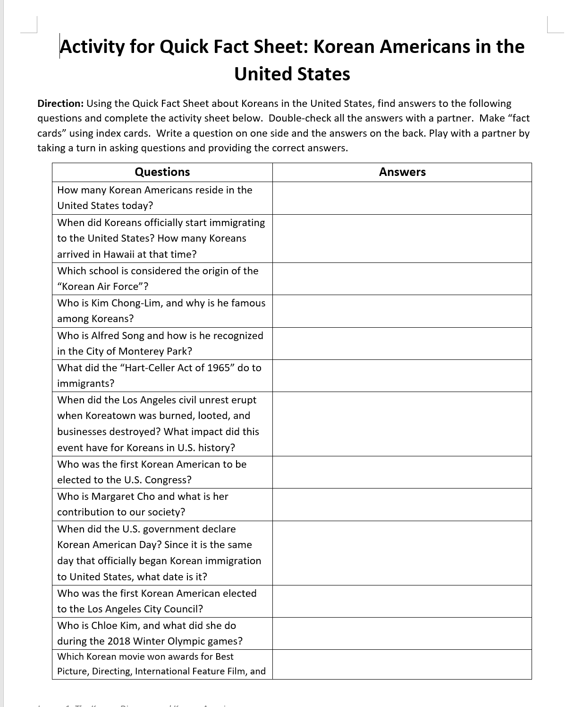
Activity 1.2

Slide 17
Lesson 1: Summative Assessment
Oral History Analysis Project

Slide 18
Korean American Oral Histories Project
Source: Korean American Oral Histories Project Website, University of California Riverside
The Korean American Oral Histories Project is a series of video interviews and documentaries of Korean Americans in the United States, collected by the Young Oak Kim Center at UC Riverside.
Interviewees include Korean Americans from all walks of life: from academics, professionals, undocumented students, to business owners talking about their experiences coming to America, stories of their family's endeavors, early childhood, and how they came to be in the position they are today.

Slide 19
Oral History Analysis https://kaoralhistories-yokcenter.weebly.com/
In pairs, go to the Oral History dropdown menu and select Location, and then choose two Korean Americans to compare for your analysis.
Review the interviews (and/or interview scripts) and make note of the following information:
What are their names?
Where are they located now?
Why did they/their family immigrate to this location?
What is an interesting fact or story they shared?
What impact have they had on their community?
Use the PowerPoint template to create a presentation on your analysis.

Slide 20
Oral History Analysis Project PowerPoint Template
Use the PowerPoint Template to create a presentation that analyzes similarities and differences in the immigrant experiences of the two Korean Americans.

Slide 21
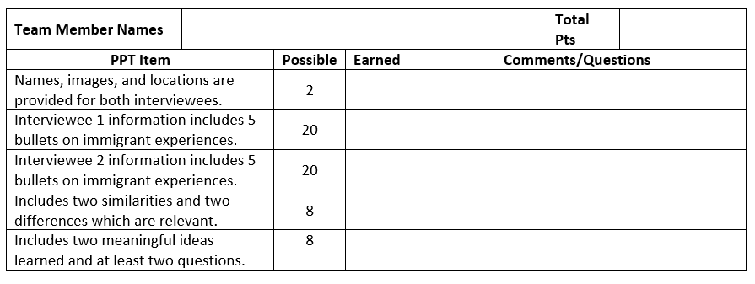
Oral Interview Analysis Project Scoring Guide
Follow the Oral History Peer Review and Scoring Guide.
In future days, you and your partner will present your analysis to the class and be evaluated by your peers.

Slide 22
Web-Based Research Report
Search the web to prepare a five-paragraph research report on a question about the Korean diaspora and/or Korean Americans.
Topic Choices
Korean Americans in one of the 50 states.
Korean immigrants to a country other than the United States.
Possible Research Areas
Immigrant arrival dates, reasons, experiences, communities, notable individuals, comparisons with other locations or timeframes
Report Requirements
Follow Scoring Rubric
Use web-based resources that are scholarly or reliable.
Cite sources.

Slide 23
What Is a Five-Paragraph Essay?
The five-paragraph essay has three basic parts: introduction, body, and conclusion.
INTRODUCTION PARAGRAPH
First paragraph of the essay.
Gets reader's attention, develops basic ideas, and provides the thesis statement.
BODY PARAGRAPHS (total of 3)
Each paragraph begins with a word or phrase transition (i.e., like First, or Another important point is).
Each paragraph develops one major idea.
CONCLUSION PARAGRAPH
Last paragraph of the essay.
Brings the essay to a close, reminds the reader of the basic ideas, and restates thesis statement.
Adapted from Five Paragraph Essay, Jackson State Community College.

Slide 24
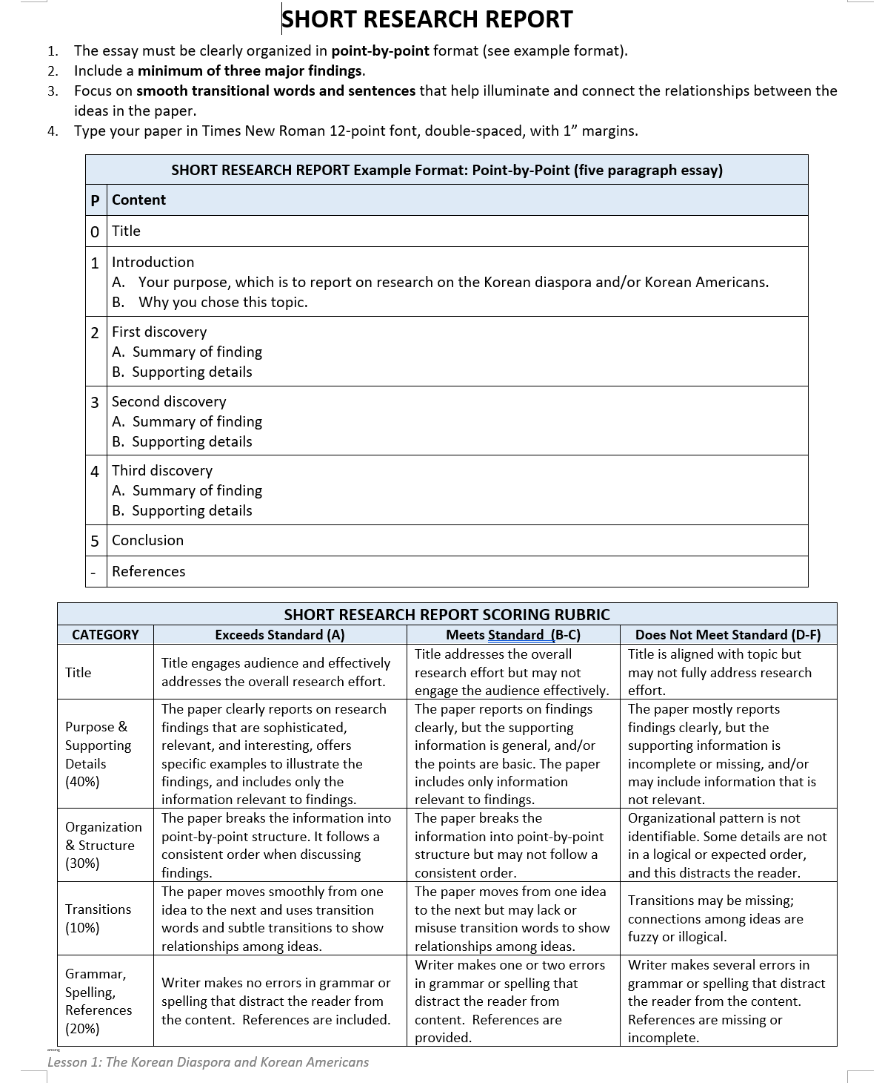
Web-Based Research Report Directions and Scoring Rubric

